Slide 1
Sexually Transmitted Diseases
Protect Yourself!

Slide 2
Interesting Facts
If herpes comes into contact with the eyes, it can cause that person to go blind.
A man who has sex with a woman who has herpes has a 50% chance of infection. A woman who has sex with a man with herpes has an 80-90% chance of infection!
Pubic Lice can live outside the body for a few hours.
More HIV is found in ejaculation. So, male to female transmission is more likely than female to male transmission. HIV can also live in the vaginal canal longer.

Slide 3
What are STIs?
STD/STI is short for sexually transmitted disease/infection .
Pass from one person to another through sexual contact.
They can be prevented if the proper precautions are taken. Some may be cured.

Slide 4
STD vs STI
Why is sexually transmitted infection , as opposed to sexually transmitted disease, now the preferred term?
A person who is infected with an STI could infect others but not show any signs of having a disease.
Some STIs can also be transferred thru inanimate objects (needles) and infect others.

Slide 5
BASIC FACTS
There are more that 20 million cases of STIs reported each year in the U.S. 30% occur in adolescents.
STIs can be serious and life threatening.
STIs are caused by pathogens that are transmitted from an infected person to an uninfected person during intimate sexual contact.

Slide 6
Abstinence
Only 100% effective way of avoiding a sexually transmitted disease.
Abstinence is refraining from any sexual activity that involves genital contact.
Vaginal Intercourse
Oral Sex
Anal Intercourse

Slide 7
Three different kinds of STIs
Bacterial- CAN be cured
Viral – CANNOT be cured! Will remain inside your body forever.
Parasite/Fungal – CAN be cured

Slide 8
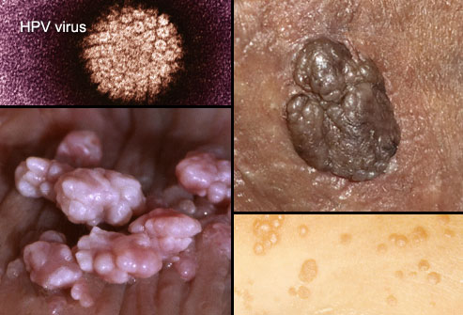
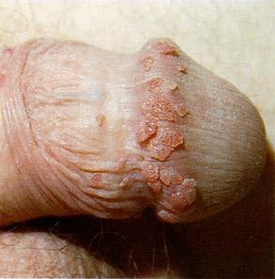
Genital Warts (HPV)
You don’t have to have sex to get an STD. Skin-to-skin contact is enough to spread HPV, the virus family that causes genital warts. Some types cause warts and are usually harmless, but others may lead to cervical or anal cancer. Vaccines can protect against some of the most dangerous types.
Signs: Pink or flesh-colored warts that are raised, flat, or shaped like cauliflower. Often there are no symptoms.

Slide 9
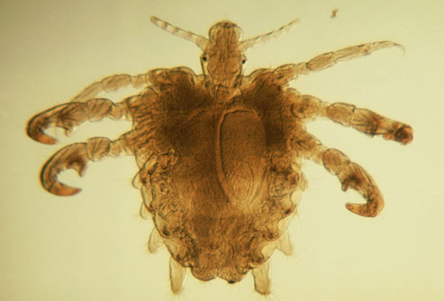
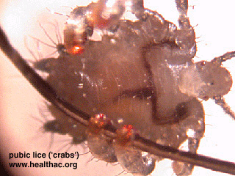
Crabs (Pubic Lice)
"Crabs" is the common term for lice that set up shop in pubic hair. The term comes from the shape of the tiny parasites, which look very different from head or body lice. The creatures crawl from one person to another during close contact. Pubic lice can be killed with over-the-counter lice-killing lotions.
Symptoms: Intense itching, tiny eggs attached to pubic hair, or crawling lice.

Slide 10
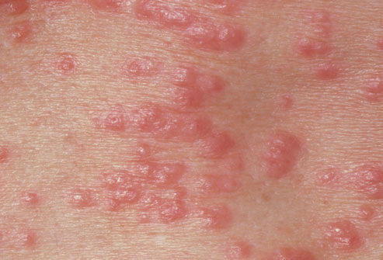
Scabies
Scabies is an itchy infestation caused by a tiny mite that burrows into human skin to lay eggs. It is not always an STD, as it can spread through any skin-to-skin contact. But among young adults, the mites are often acquired during sex. Scabies is treated with prescription mite-killing creams.
Symptoms: Intense itching especially at night and a pimple-like rash. It may take 2-6 weeks for symptoms to appear.

Slide 11
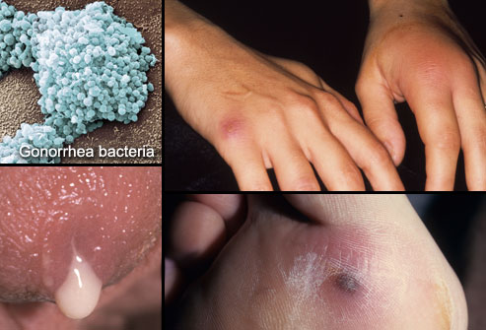
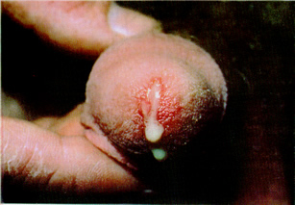
The Clap (Gonorrhea)
Gonorrhea spreads easily and can lead to infertility in both men and women, if untreated. Antibiotics stop the infection.
Symptoms: Common symptoms are burning during urination and discharge, but often there are no early symptoms. Later, the infection may cause skin rashes or spread to the joints and blood.
In Men: Discharge from the penis, swollen testicles.
In Women: Vaginal discharge, pelvic pain, spotting. Symptoms may be mild and are easily confused with a urinary tract or vaginal infection.

Slide 12
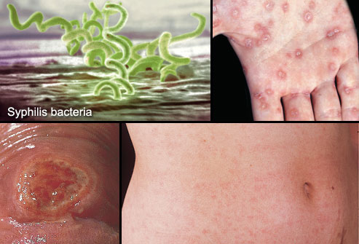
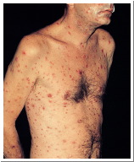
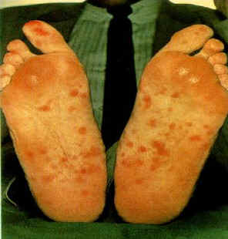
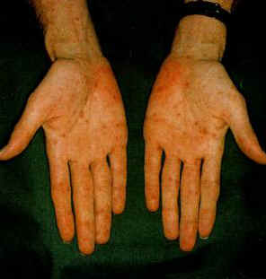
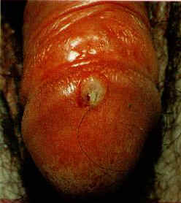
Syphilis
Most people don't notice the early symptoms of syphilis. Without treatment, it can lead to paralysis, blindness, and death. Syphilis can be cured with antibiotics.
Signs and Symptoms: The first sign is usually a firm, round, painless sore on the genitals or anus. The disease spreads through direct contact with this sore. Later there may be a rash on the soles, palms, or other parts of the body (seen here), as well as swollen glands, fever, hair loss, or fatigue. In the late stage, symptoms come from damage to organs such as the heart, brain, liver, nerves, and eyes.

Slide 13
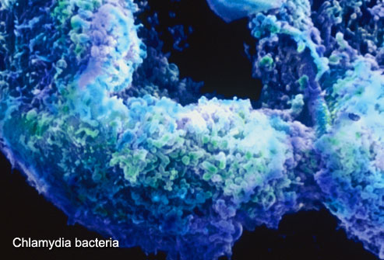
Chlamydia
Chlamydia is a common STD that can lead to infertility if left untreated. It clears up quickly with antibiotics. But it often goes unnoticed because symptoms are vague or absent. Chlamydia can also infect the rectum and throat.
Symptoms in Men: Burning and itching at the tip of the penis, discharge, painful urination.
Symptoms in Women: Vaginal itching, discharge that may have an odor, pain during sex, painful urination.

Slide 14
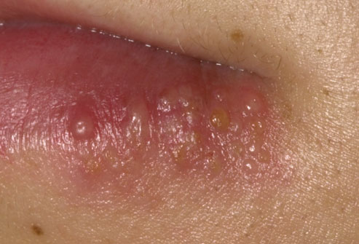
Herpes
That painful cold sore you get on your lip every now and then? It’s probably caused by a type of herpes virus called HSV-1. This virus is usually not an STD; it spreads easily among household members or through kissing. But it can be spread to the genitals through oral or genital contact with an infected person. Though there is no cure, drugs can shorten or prevent outbreaks.
Signs and Symptoms: Occasional cold sores or “fever blisters” on the lips. Smallor sores on

Slide 15
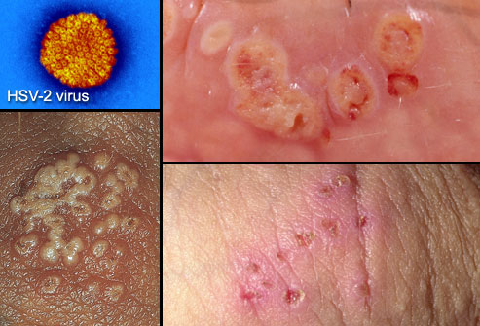
Herpes Simplex Virus Type 2
Most cases of genital herpes are caused by a virus called HSV-2. It’s highly contagious and can spread through intercourse or direct contact with a herpes sore. As with HSV-1, there is no cure. But antiviral drugs can make outbreaks less frequent and help clear up symptoms more quickly.
Symptoms: Fluid-filled blisters that form painful, crusted sores on the genitals, anus, thighs, or buttocks. Can spread to the lips through oral contact.

Slide 16
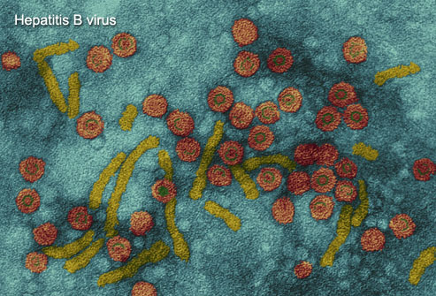
Hepatitis
Hepatitis B is a stealthy virus that can cause severe liver damage. It spreads through contact with blood and other body fluids. People can be infected through sex, needle sharing, and at birth, as well as by sharing razors and toothbrushes. There is no cure, but drugs can keep the virus in check. There’s also an effective vaccine to prevent hepatitis B.
Symptoms: People may develop nausea, belly pain, dark urine, fatigue, and a yellowing of the skin or eyes with acute infection. Chronic infection can lead to liver cirrhosis and liver cancer. Many people have no symptoms for years.

Slide 17
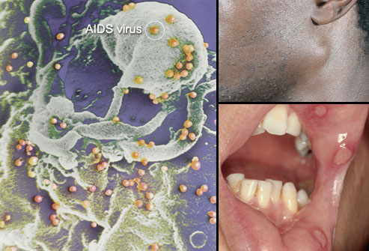
HIV/AIDS
The HIV virus weakens the body’s defense against infections. HIV spreads through unprotected sex, needle sharing, or being born to an infected mother. It may cause no symptoms for years, so a blood test is the best way to learn your status. Timely treatment is important to help prevent serious illnesses.
Early symptoms of HIV Infection: Many have no symptoms, but some people get temporary flu-like symptoms 1-2 months after infection: swollen glands (seen here), a fever, headaches, and fatigue. Canker sores in the mouth can occur, too.

Slide 18
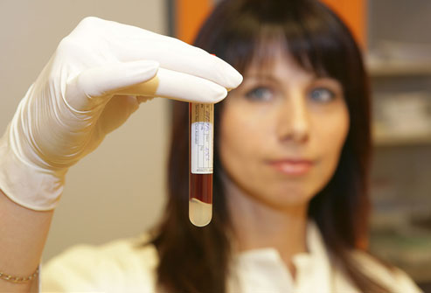
HIV/AIDS Testing
Reliable HIV tests can be done in a clinic or at home with the FDA-approved Home Access brand test kit. Anonymous tests use only a number to identify you. One limitation is the "window period" of up to 6 months after exposure to HIV when these antibody tests sometimes do not find the virus. You can pass HIV to others during that time.
If You Suspect HIV/AIDS: If you've been exposed to HIV, starting medications immediately can prevent infection. If you have the virus, treatments can help prevent HIV from turning into AIDS.

Slide 19
HIV/AIDS Treatment Options NO CURE
HIV/AIDS Treatment Options
While there is no cure for HIV, there are medications that can suppress the amount of virus multiplying inside the body. People take a combination of antiviral drugs in hopes of preventing the infection from advancing to AIDS. Additional treatments can help prevent or fight off serious infections, if the immune system has weakened.

Slide 20
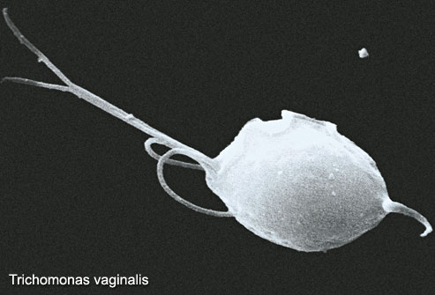
Trichomoniasis
Trichomoniasis is caused by a parasite that spreads during sexual contact. It can be cured with prescription drugs.
Signs and Symptoms in Men: Most men have no obvious symptoms. Some develop a mild discharge or slight burning during urination.
Signs and Symptoms in Women: Women may develop a yellow-green discharge with a strong odor, vaginal itching, or pain during sex or urination. Symptoms usually begin 5 to 28 days after acquiring the parasite.

Slide 21
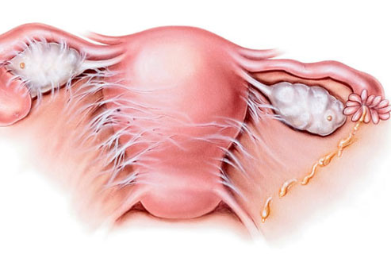
Pelvic Inflammatory Disease PID
Not an STD itself, pelvic inflammatory disease (PID) is a serious complication of untreated STDs, especially chlamydia and gonorrhea. It happens when bacteria spread to infect the uterus and other female reproductive organs. Prompt treatment is essential to prevent damage to a woman’s fertility.
Signs and Symptoms: Lower abdominal pain, fever, unusual discharge, painful intercourse, painful urination, and spotting. There are often no warning signs.

Slide 22
Who is at risk for STD’s?
Anyone who is sexually active is at risk for an STD, regardless of gender, race, social class, or sexual orientation. That said, teenagers and young adults acquire STDs more easily than older people. By age 25, half of sexually active adults get an STD. Having multiple sex partners also raises your risk.

Slide 23
Can Virgins Get STD’s ?
Yes, they can. Many STDs spread through any type of sexual activity, including skin-to-skin contact and oral sex. This is especially true of STDs that produce genital lesions or sores.

Slide 24
Preventing STD’s
The best ways to avoid getting an STD are to abstain from any sexual contact and be in a monogamous, long-term relationship with an uninfected partner. To reduce your odds of getting STDs:
Ask your partner if he or she has an STD.
Ask partners to be tested before sexual activity.
Use condoms.
Avoid sexual activity if your partner has signs of an STD.
Be aware of symptoms and get regular checkups with your health care provider.

Slide 25
The Limits of Condoms
While condoms are effective in preventing the spread of some STDs, they are not perfect. Condoms are better at protecting against gonorrhea, chlamydia, HIV, and trichomoniasis. But they offer less protection against herpes, syphilis, and genital warts. These infections can spread through contact with skin lesions that are not covered by a condom. Finally, condoms offer virtually no protection against crabs and scabies.
THERE IS NO CONDOM TO PROTECT YOUR HEART!!!!

Slide 26
How to Tell your Partner
If you think you have an STD, tell your partner(s) as soon as possible. You may be able to spread the infection even if you have already begun treatment or are using condoms. With some STDs, doctors recommend treating both partners at the same time. This may be a difficult conversation. Some people find it helpful to write a script ahead of time. Be sure to let your partner ask questions and express his or her feelings.

Slide 27
STD’s and Pregnancy
It is important for pregnant women to be checked for STDs. They can cause women to go into labor too early and may complicate delivery. Many STDs can be passed from mother to baby during pregnancy, childbirth, or after the baby is born. STDs effects on babies can include stillbirth, low birth weight, neurologic problems, blindness, liver disease, and serious infection. But there are treatments to minimize these risks. Treatment during pregnancy can cure some STDs and lower the risk of passing the infection to your baby.

Slide 28
Can STD’s come back?
Most STD treatments do not protect you from getting the same infection again. A course of drugs may cure gonorrhea, syphilis, chlamydia or trichomoniasis, but a new exposure can start a new infection. If your partner is not treated, you can continue to pass infections back and forth. And if you're not taking the right precautions to protect yourself, you can be re-infected quickly or even pick up a second STD.

