Slide 1
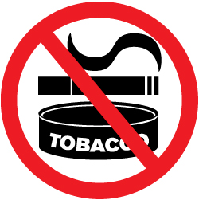
The Dangers of Tobacco

Slide 2
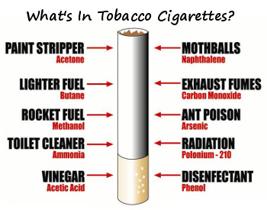
What is Tobacco?
Tobacco is a plant that contains nicotine. Its leaves are dried and then made into cigarettes, cigars, smokeless tobacco and other products. People smoke, chew and inhale these products.

Slide 4
How Tobacco Affects the Body
Brain – Nicotine causes the release of chemical in the brain that makes tobacco users crave tobacco.
Heart – as a result of atherosclerosis, the heart must work harder to pump blood. This extra stress on the heart can lead to high blood pressure, heart attack and stroke.
Lungs – smoking blocks the airways, impairs the lungs, and increases the risk of lung cancer and other respiratory diseases.
Skin – smoking ages and wrinkles the skin.
Fingers – long term tobacco use can stain the fingers yellow.
Mouth teeth and throat – tobacco causes bad breath stains on teeth and decrease the senses of taste and smell. It can cause gum disease, mouth, throat, and esophageal cancer.
Stomach, colon, and bladder – Tobacco can cause stomach ulcers and bladder, kidney and stomach cancers.

Slide 5
Mouth

Slide 6
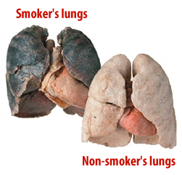
Lungs

Slide 7
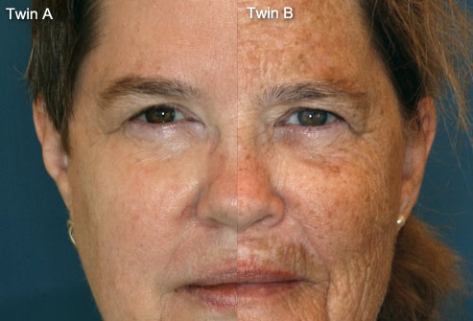
Skin

Slide 8
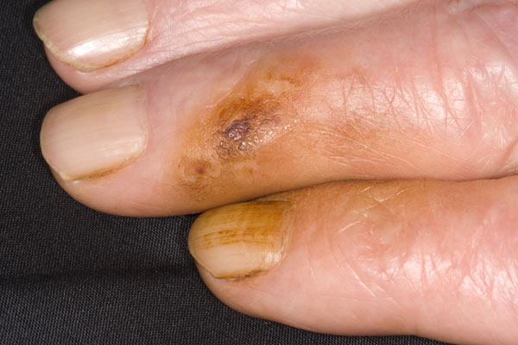
Fingers

Slide 9
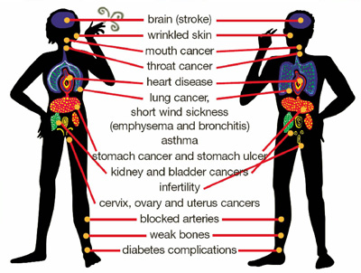

Slide 10
What exactly happens when one smokes?
Airway of the lungs immediately constricted, decreased lung function hindering physical activity
Nagging coughs and shortness of breath common
Increased heart rate
Elevated blood pressure
Carbon monoxide in blood deprives body cells of oxygen.
Hazardous chemicals carried in blood, expose carcinogens to body tissues.
Wherever smoke touches any cells, it harms them.

Slide 11
Smoking Advertisments

Slide 12
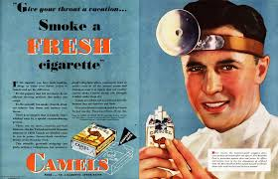

Slide 13
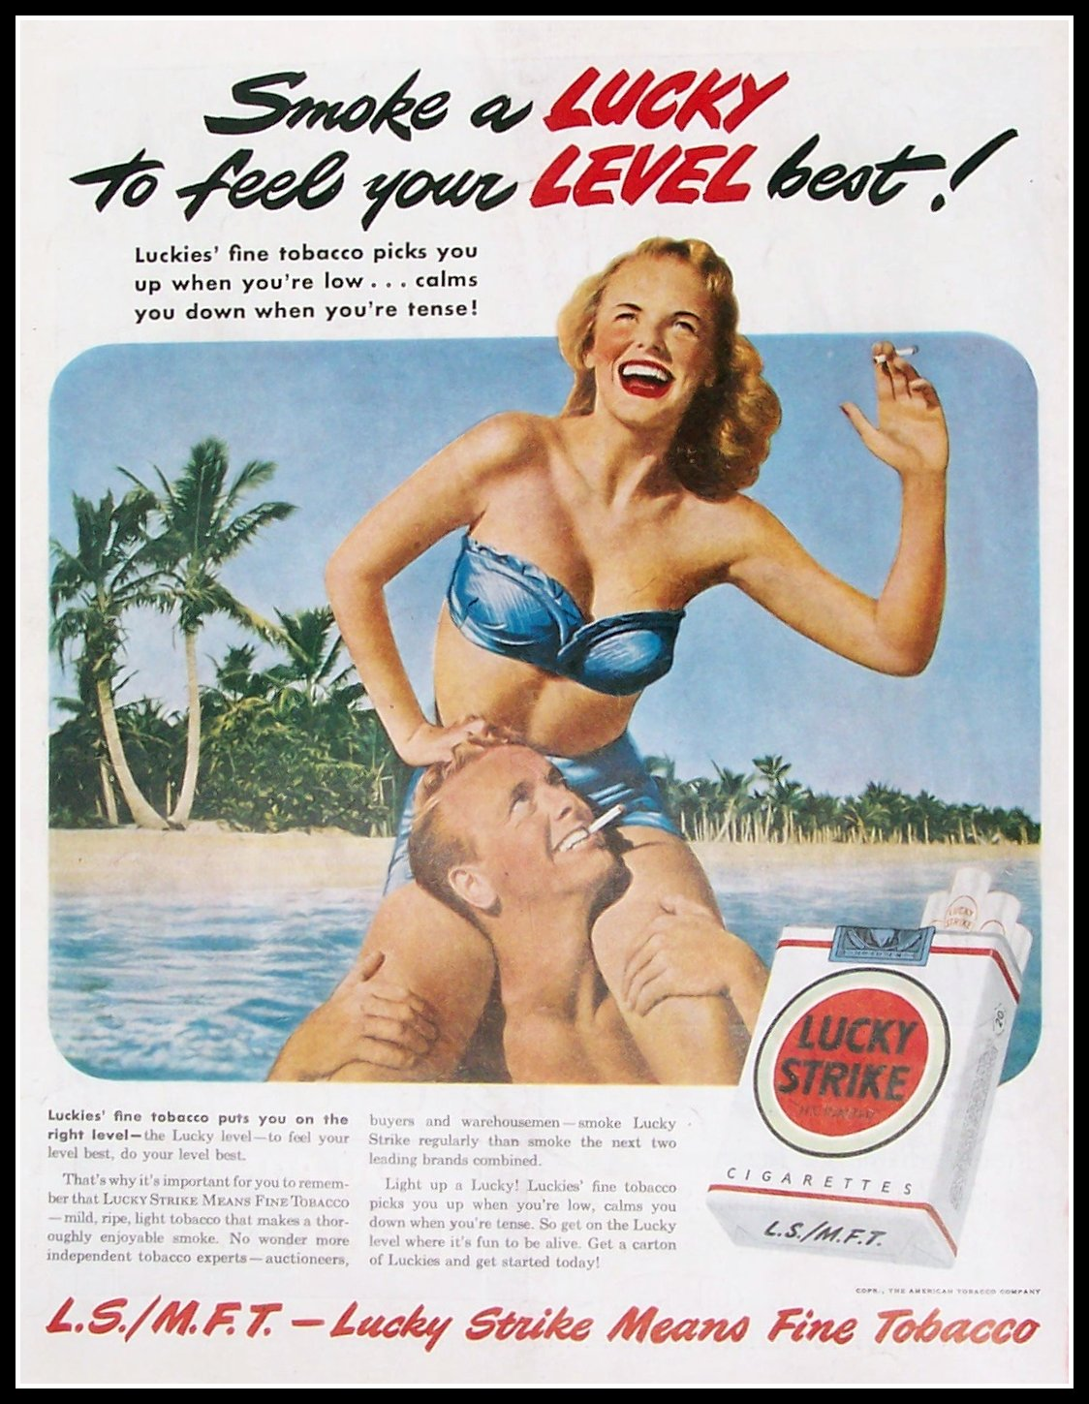
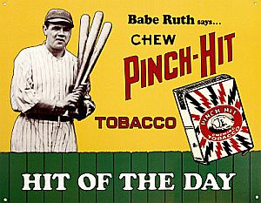

Slide 14
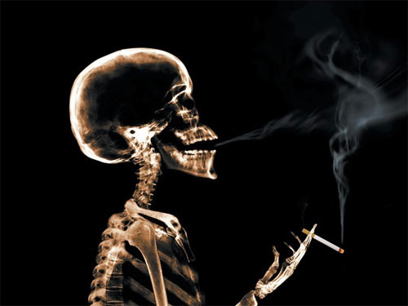
Student Activity: Ad Creation
Students will work alone to create an Ad that encourages the public not to smoke. In your advertisement, you must include 3 effects smoking has on your health. Have fun and be creative!

