Slide 1
Sexuality

Slide 2
What is Sexuality?
When people see the words “Sex” or “sexuality” they think of sexual intercourse or sexual activities.
Sexuality is much more than sexual feelings or sexual intercourse.
It is an important part of who a person is and who they will become.

Slide 3
What is Sexuality?
Sexuality includes:
Feelings, thoughts, and behaviors related to being female or male
Being attractive/attracted to others
Being in love
Being in a relationship that includes sexual intimacy.
Enjoyment of the world through the five senses;
taste, touch, smell, hearing, and sight.

Slide 4
S E X U A L I T Y
S-E-X are only three letters in the word sexuality.
There is much more to sexuality than sex.

Slide 5
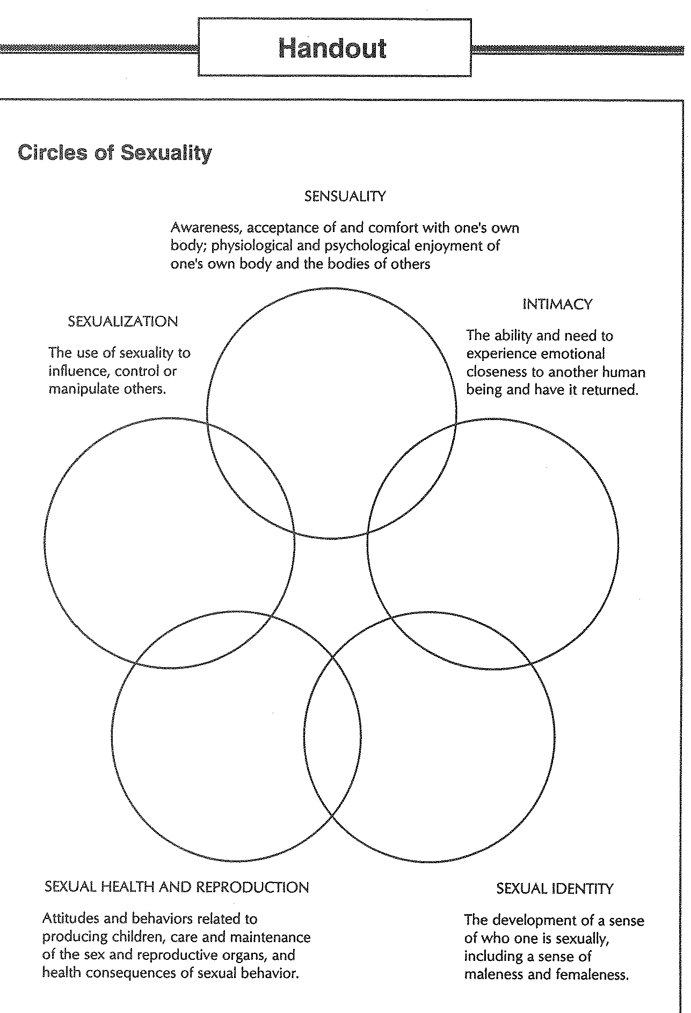

Slide 6
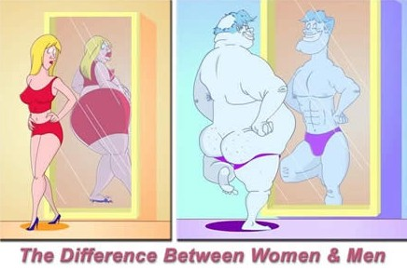
Sensuality
Awareness, acceptance of and comfort with one’s own body; physiological and psychological enjoyment of one’s own body and the bodies of others.
Elements:
Body Image
Human Sexual Response Cycle (Excitement, Plateau, Orgasm, Resolution)
Skin Hunger (craving to be touched)
Fantasy

Slide 7
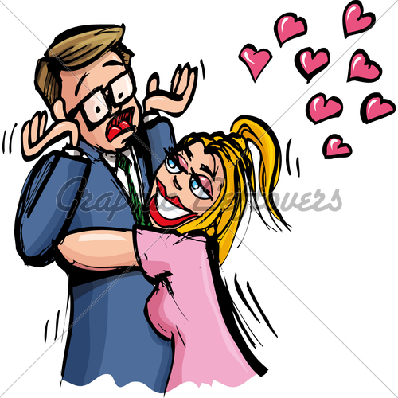
Intimacy
The ability and need to experience emotional closeness to another human being and have it returned.
Elements:
Caring
Sharing
Loving/Liking
Risk Taking
Vulnerability

Slide 8
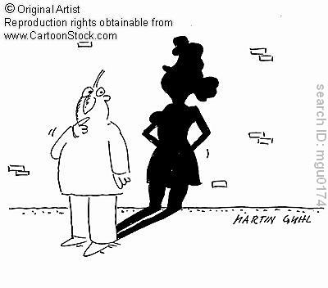
Sexual Identity
The development of a sense of who one is sexually, including a sense of maleness and femaleness.
Elements:
Bias
Gender Identity
Gender Role
Sexual Orientation (attraction to same sex, opposite sex, or both)

Slide 9
Gender Identity vs. Gender Role
Gender Identity- a person's sense of identification with either the male or female sex, as manifested in appearance, behavior, and other aspects of a person's life.
Gender Role- the way an individual expresses to others the degree of their maleness or femaleness
your gender role is the public expression of your gender identity.

Slide 10
Sexual Health and Reproduction
Attitudes and behaviors related to producing children, care and maintenance of the sex and reproductive organs, and health consequences of sexual behavior.
Elements:
Factual Information
knowing about your sexual health and how reproduction works)
Feelings and Attitudes
Intercourse
Physiology and Anatomy of Reproductive Organs
Sexual Reproduction

Slide 11
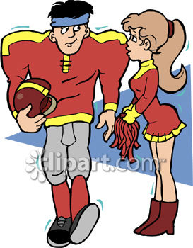
Sexualization
The use of sexuality to influence, control or manipulate others.
Elements:
Flirting
Rape
Incest
Sexual Harassment

Slide 12
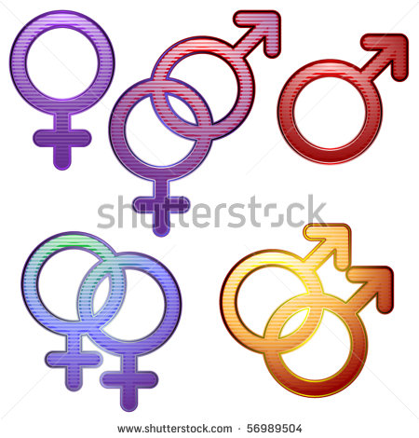
Questions about the
Cycle of Human Sexuality?

