Slide 1
The Endocrine System
Regulates the body’s functions.

Slide 2
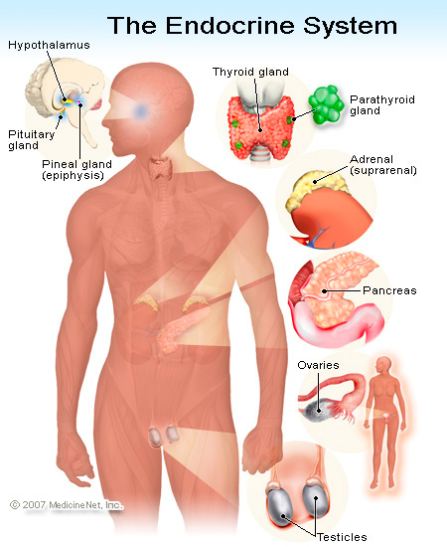
Big Idea
Your endocrine system sends and receives chemical messages that control many body functions.
The endocrine system includes various organs that work together to regulate body functions.
The endocrine system sends and receives hormones.

Slide 3


Important Vocabulary
endocrine glands
hormones
thyroid gland
parathyroid glands
pancreas
pituitary glands
adrenal glands

Slide 4
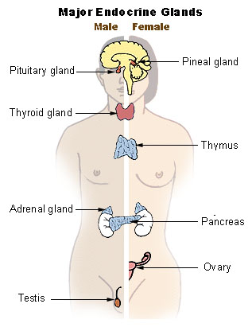
How Does the Endocrine System Work?
There are several different endocrine glands

Slide 5
How Does the Endocrine System Work?
Endocrine glands secret hormones into the blood to influence physical and mental responses.
The thyroid gland produces thyroxine, which regulates the way cells release energy from nutrients.
The parathyroid glands are located in the neck near the thyroid gland.
The pancreas is an endocrine gland that secretes two hormones—glucagon and insulin—that regulate the level of glucose in the blood.

Slide 6
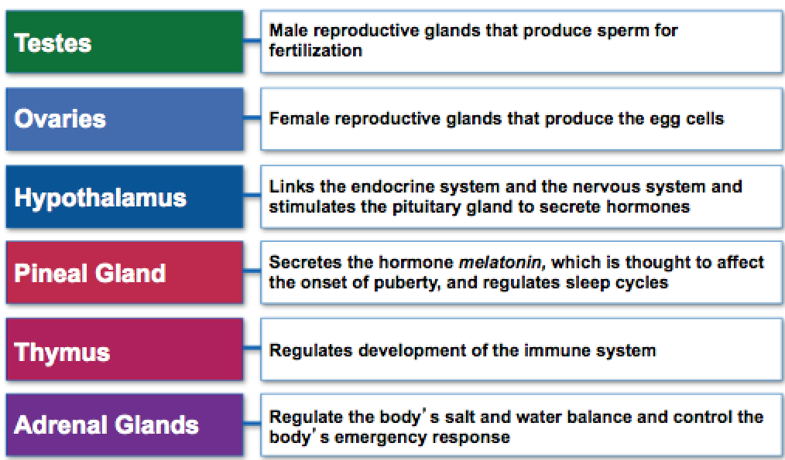

Slide 7
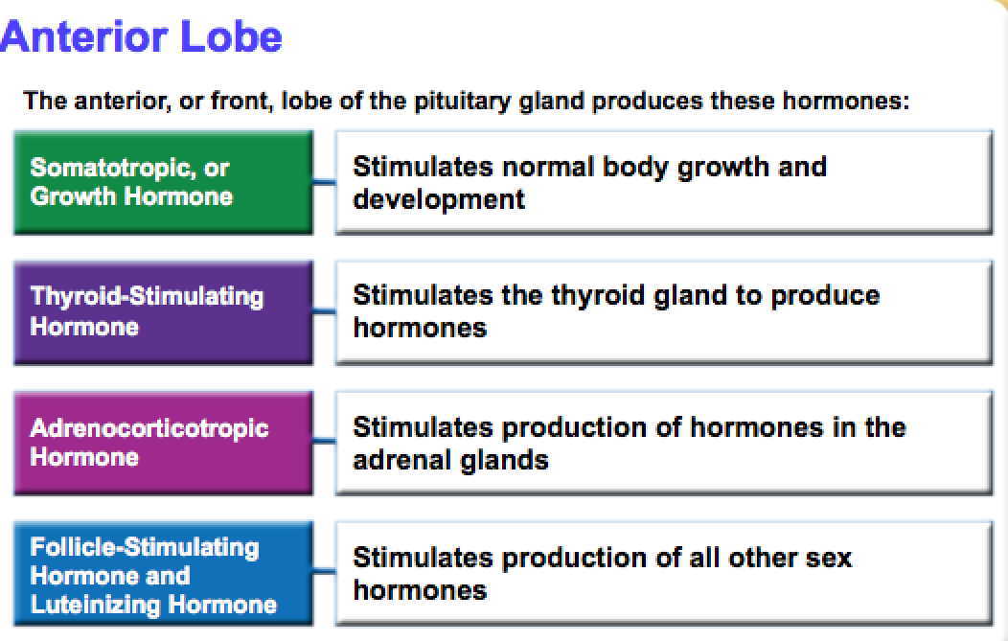
The Pituitary: The Master Gland
Known as the master gland, the pituitary gland has three sections, or lobes: anterior, intermediate, and posterior.
Pituitary Glad regulates and controls
the activities of all other endocrine glands

Slide 8
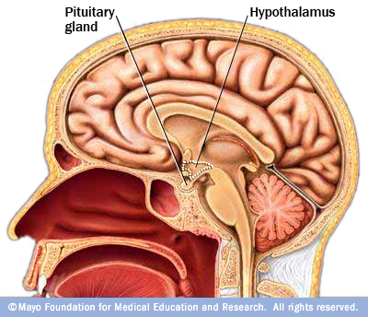
The Pituitary: The Master Gland
Intermediate Lobe:
  The intermediate, or middle, lobe of the pituitary secretes melanocyte-stimulating hormone, which controls the darkening of the pigments in the skin.
The posterior, or rear, lobe of the pituitary secretes antidiuretic hormone that
  regulates the balance of water in the body, and
  produces oxytocin, which stimulates the smooth muscles in the uterus during pregnancy, causing contractions during the birth of a baby.

Slide 9
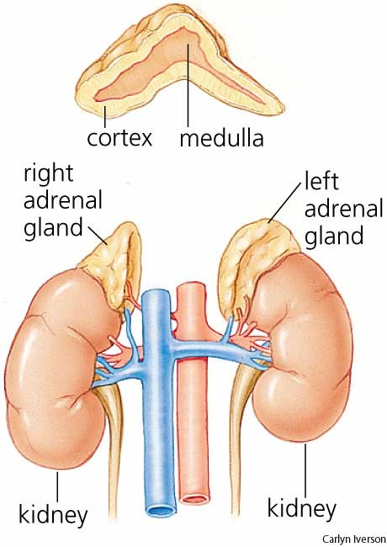
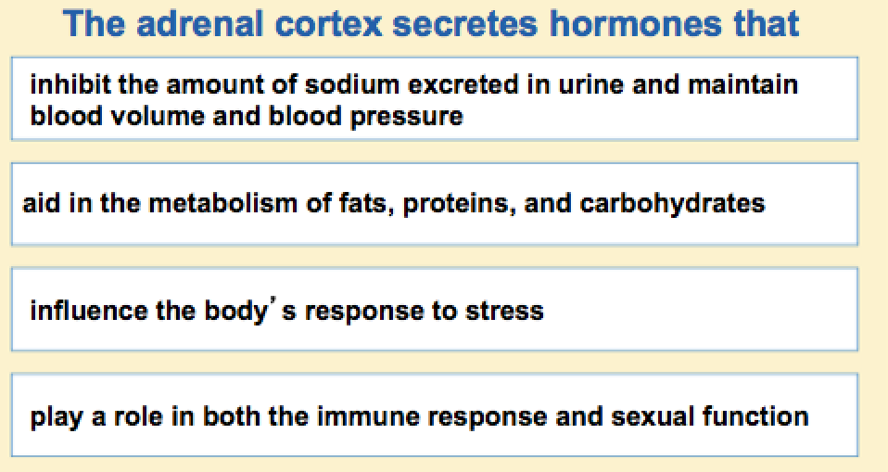
The Adrenal Glands
The adrenal glands each have two parts: the adrenal cortex and the adrenal medulla.
  Help the body deal with stress and respond to emergencies

Slide 10
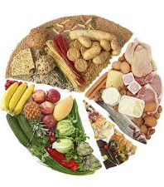
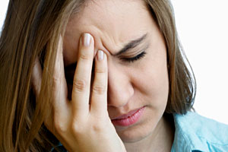
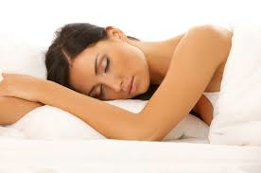
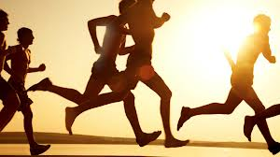
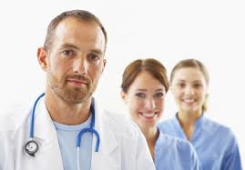
Maintaining Your Endocrine Health
Eat balanced meals to ensure that you get the nutrients you need.
Use stress-management techniques.
Get 8 ½ to 9 hours of sleep every night.
Engage in regular physical activity.
Have regular medical checkups.

Slide 11
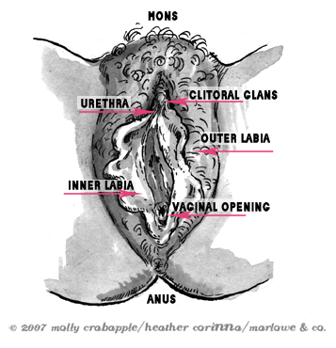
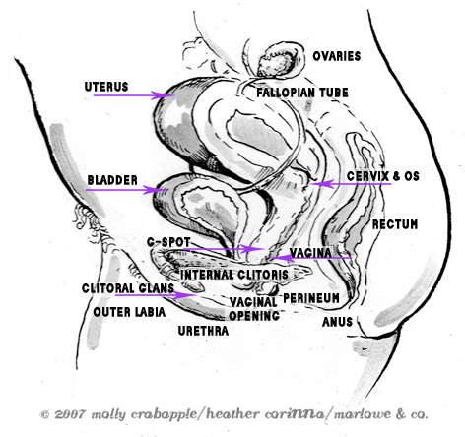
Female
Reproductive System

Slide 12
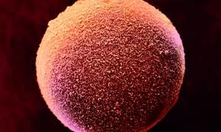
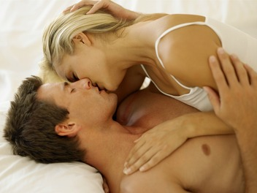
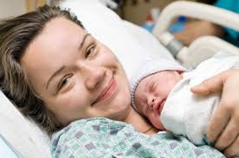
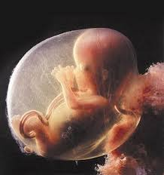
What does the Female Reproductive System do?
Produce Eggs (Ova)
Have Sexual Intercourse
Protect and nourish the fertilized egg until it is fully developed
Give Birth

Slide 13
The Female Reproductive System
http://kidshealth.org/teen/interactive/female_it.html

Slide 14
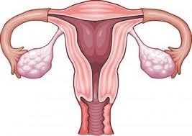
Internal Organs
Ovaries
  Most females have two ovaries which contain eggs
  Eggs- the female reproductive cell
  They are small, oval-shaped glands that are located on either side of the uterus. The ovaries store eggs and produce hormones.
The vast majority of the eggs within the ovaries steadily die, until they are depleted at menopause.
At birth, there are approximately 1 million eggs; and by the time of puberty, only about 300,000 remain.
  Of these, 300 to 400 will be ovulated during a woman's reproductive lifetime.
The eggs continue to degenerate during pregnancy, with the use of birth control pills, and in the presence or absence of regular menstrual cycles.

Slide 15
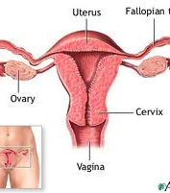
Internal Organs
Fallopian Tubes
  These are two narrow tubes that are attached to the upper part of the uterus and serve as tunnels for the ova (egg cells) to travel from the ovaries to the uterus.
  Conception normally occurs here

Slide 16
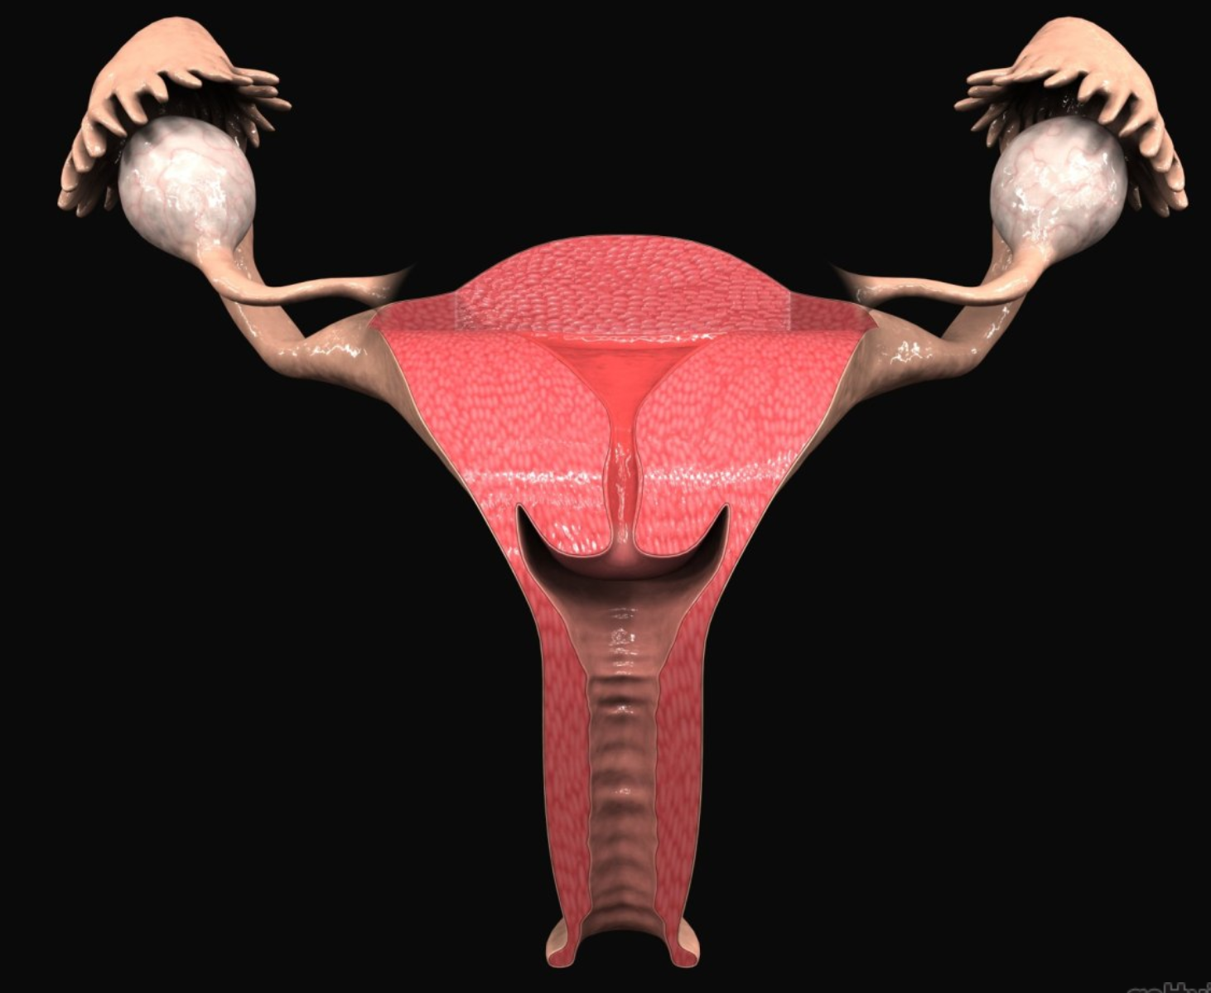
Internal Organs
Fimbrae or Fimbria
  Are finger-like structures located at the ends of a fallopian tube
  Ovaries and fallopian tubes are not connected, eggs are collected by fimbrae into the fallopian tubes

Slide 17
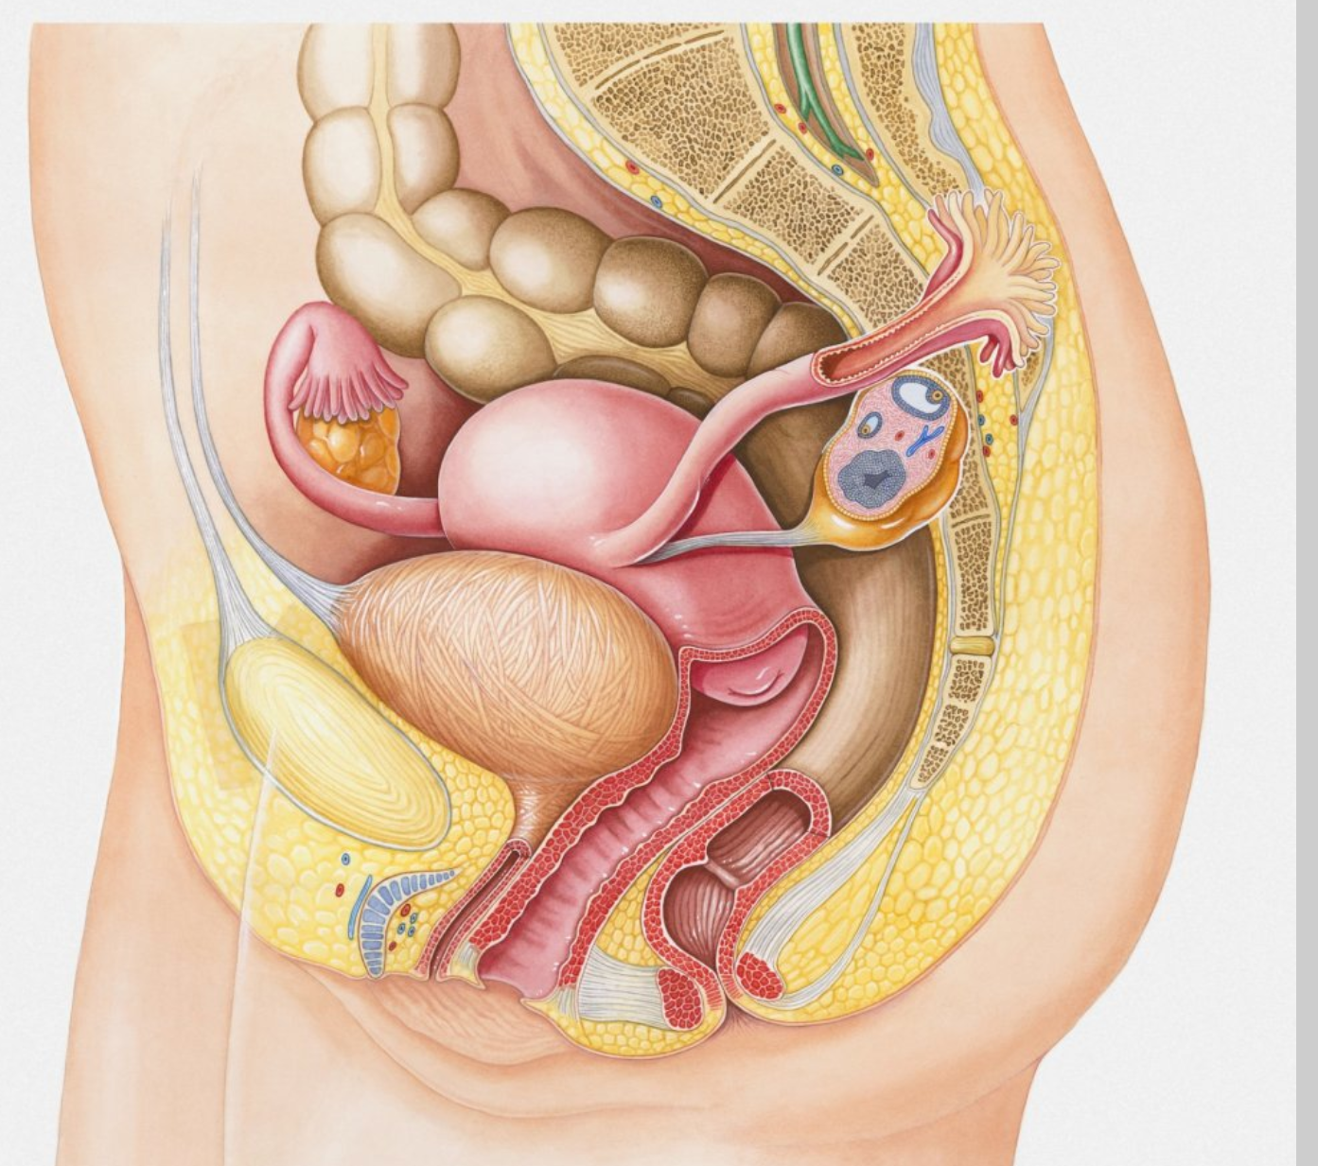
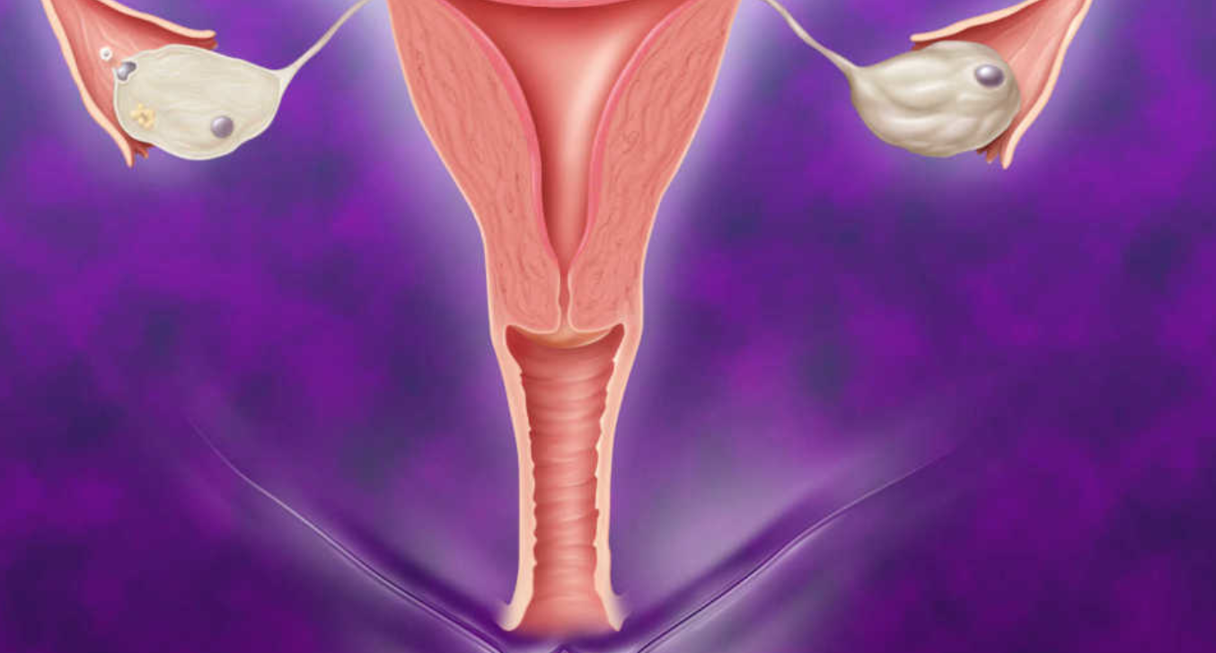
Internal Organs
Uterus (womb)
  is a hollow, pear-shaped organ that is the home to a developing fetus.
Two Parts:
  Corpus – main structure of uterus, expands to house fetus
  Cervix - lower part that opens into the vagina
    Has a channel through that allows sperm to enter and menstrual blood to exit

Slide 18
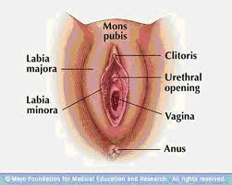
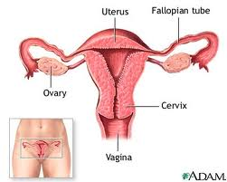
Internal Organs
Vagina
  is a canal that joins the cervix (the lower part of uterus) to the outside of the body
  Is used for intercourse, menstrual flow, and is the birth canal

Slide 19
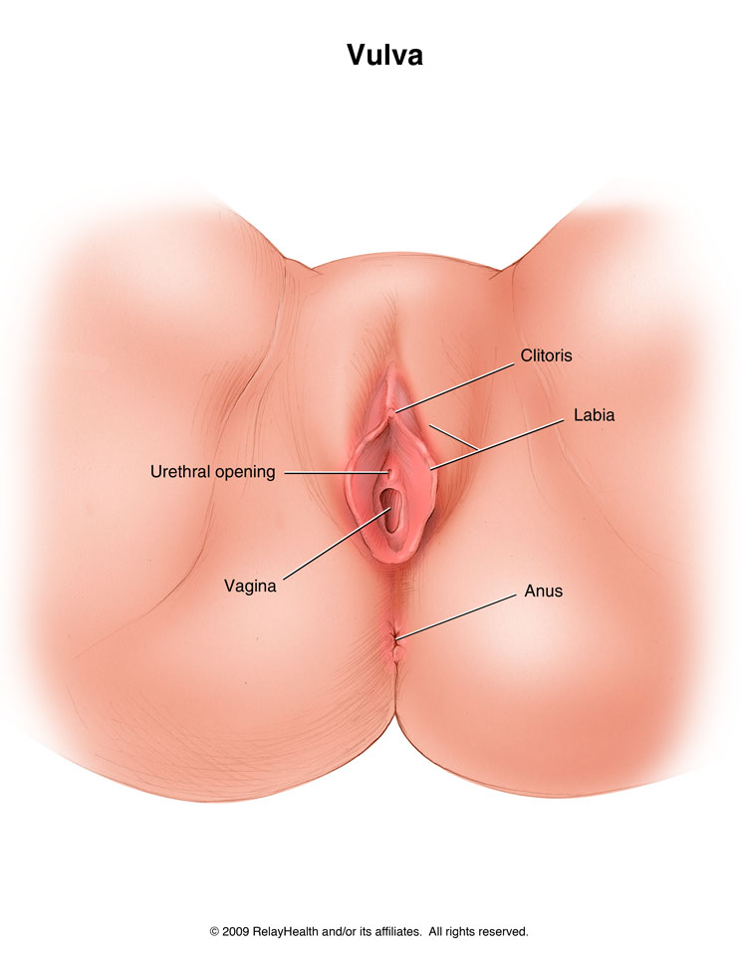
External Structures
Vulva
overall term used for all external organs of female reproductive system

Slide 20
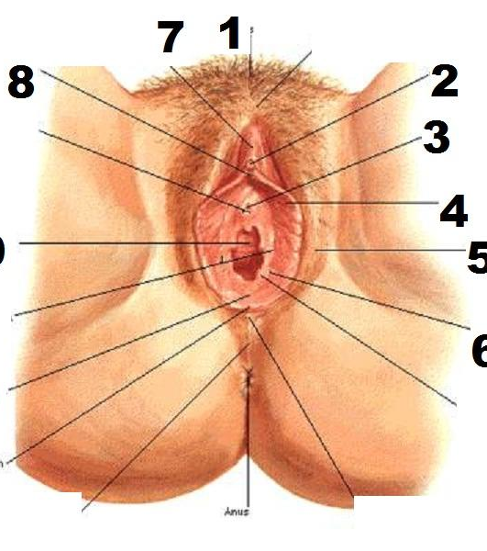
External Structures
Clitoris
  The source of sexual stimulation due to nerve-endings
  The two labia minora meet at the clitoris above the vaginal opening
  The clitoris is covered by a fold of skin, called the Clitoral Hood

Slide 21
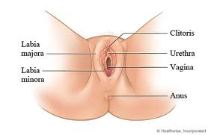
External Structures
Labia Majora
  The labia majora encloses and protects the other external reproductive organs.
  Literally translated as "large lips," the labia majora are relatively large and fleshy
  After puberty, the labia majora are covered with hair
Labia Minora
  Literally translated as "small lips"
  They lie just inside the labia majora, and surround the openings to the vagina and urethra
    The urethra is located between the clitoris and the vaginal opening

Slide 22
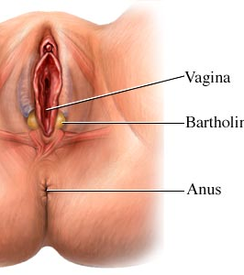
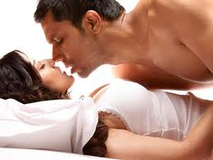
External Structures
Bartholin's Glands
  These glands are located on each side of the vaginal opening
  They produce a lubricating fluid (mucus) during sexual arousal

Slide 23
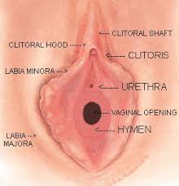
External Structures
Hymen
  A thin, pink membrane that covers the vaginal opening in some virginal girls

Slide 24
Hormones
Estrogen
Progesterone
  female sex hormone produced by the ovaries
  hormone that is produced in the ovaries which prepares and maintains the uterus for pregnancy

Slide 25
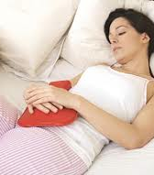
Menstruation
Monthly shedding of uterine lining
  Uterine lining is also know as Endometrium
This “period” normally lasts from 3 to 7 days
The first day of blood flow is considered Day One of the cycle

Slide 26
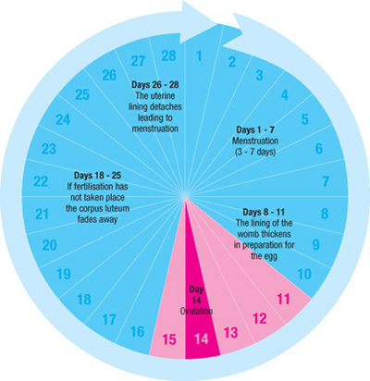
Ovulation
Monthly release of an egg or ova
  Usually occurs in the middle of a female’s cycle: roughly day 14
The Endometrium thickens in preparation of a fertilized egg
If no such egg arrives, the female will go through menstruation

Slide 27
FEMALE HEALTH CONCERNS

Slide 28
VAGINITIS
Irritation / inflammation of the vagina usually accompanied by a discharge
Yeast Infection: fungus
Trichomoniasis: protozoan
Gardnerella: bacteria

Slide 29
Yeast Infection
SYMPTOMS: curdy white vaginal discharge, swollen tender, red itching labia, burning during urination
CAUSE: yeast like fungus Monilia, when PH balance is disturbed
RISK: increases with pregnancy,diabetes,antibiotics, “the pill”, high sugar intake, alcohol, tight clothing, non-ventilating clothing

Slide 30
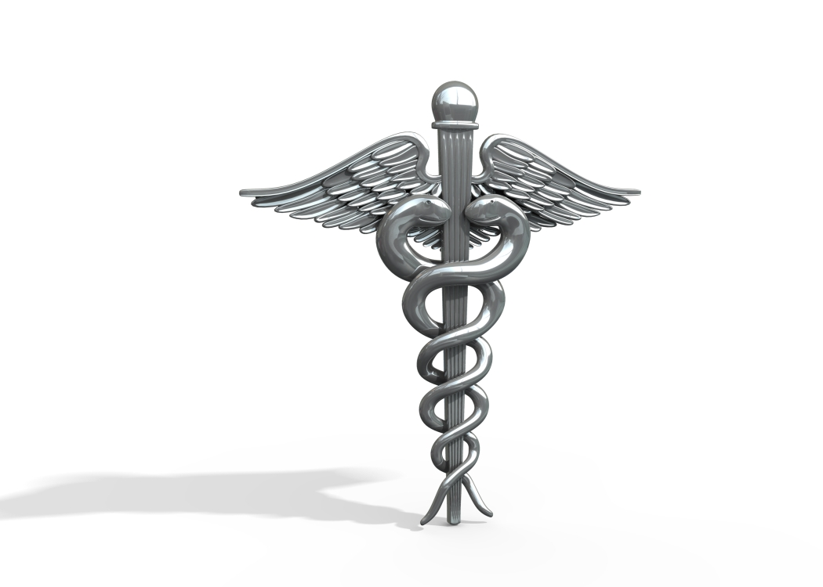
YEAST INFECTION
PREVENTION: showers, cotton clothing, bathing suits, avoid douches, avoid bubble baths, eating yogurt with antibiotics help
TREATMENT:
non-prescription
Such as:
Gyne-Lotrimin
Mycelex

Slide 31
TOXIC SHOCK SYNDROME
CAUSE: Bacteria
STAPHYLOCOCCUS injures victim by producing a toxin in the blood stream
SYMPTOMS: sudden high fever, vomiting, diarrhea, sunburn like rash, drop in blood pressure, shock, kidney failure, heart failure, DEATH…

Slide 32
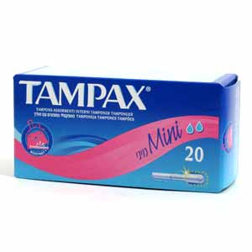
TSS
PREVENTION: tampons changed frequently, alternate use of tampons and sanitary napkins, keep hands clean.
TREATMENT:
Antibiotics
Note: can arise from wounds in throat, skin, lungs and bone

Slide 33

BREAST CANCER
CAUSE:UNKNOWN malignant tumors grow in breast
RISK FACTORS:
  Age over 50
  Menarche prior to 12
  No pregnancies
  1st child after 30
  Heredity
  Caucasian ( Afro-American more likely to die)

Slide 34
BREAST CANCER
Lesson risk: EARLY Detection
  Breast exam yearly after 40
  TREATMENT: radiation, lumpectomy, mastectomy
  Most common form of cancer in females

Slide 35
CERVICAL CANCER
ABNORMAL GROWTH OF CELLS IN CERVIX
DETECTION : pap-smear
PREDISPOSITION:
  Earlier adolescent female has intercourse
  Greater number of sexual partners
  HPV
  Vaginal , Ovarian, Uterine Cancer

Slide 36
MENSTRUAL PROBLEMS
Amenorrhea- absence
Oligomenorrhea- irregular
Dysmenorrhea- painful
Menorrhagia- abnormal heavy

Slide 37
PREMENSTRUAL SYNDROME
GENERALLY OCCURS 4 DAYS BEFORE AND 4 DAYS DURING MENSTRUATION
SYMPTOMS
Ranges from slight bloating to weight gain, nervous tension, emotional distress, migraines, temper tantrums……
CAUSE:
Changing hormonal levels two days to two weeks prior to menstruation

Slide 38
PMS
PREVENTON: DIET: eat 6 small healthy meals a day, avoid sugar, salt, alcohol, caffeine, red meat and fat, drink water EXERCISE: walking, swimming, biking,etc.
TREATMENT: controversial hormonal treatment, diet, exercise

Slide 39
MENOPAUSE
SYMPTOMS: hot flashes ( lack of estrogen, imbalance between ovaries and hypothalamus)
Average age 50
CAUSE: functioning of the ovaries declines, menstrual cycle and reproductive functions cease
TREATMENT: estrogen therapy

Slide 40
Male Reproductive System
Please turn to the vocabulary page in your packet !
Follow along and copy the definitions in your packet.

Slide 41
Vocabulary words 1-6
Puberty: period of sexual development during which males and females become sexually mature.
CAPABLE OF REPRODUCTION
Pituitary Gland : small endocrine gland releases FSH and LH ( where is it located?)
Follicle Stimulating Hormone: Stimulates sperm production.
Luteinizing Hormone: Stimulates testosterone production.
Hypothalamus : portion of the brain that regulates the endocrine system.
Endocrine System: body system which are ductless glands that release hormones.

Slide 42
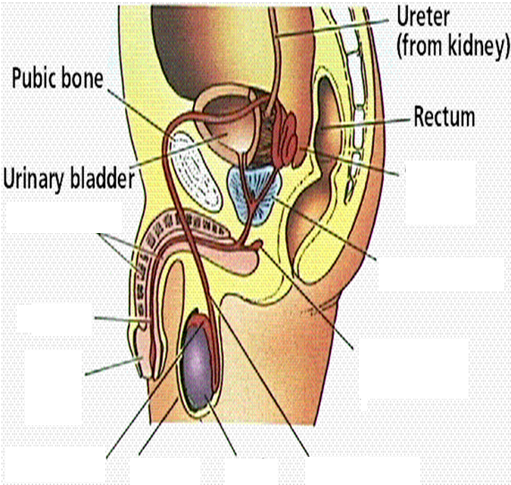
Penis #7
The male organ through
which urine and semen
leave the body.
Penis

Slide 43
Scrotum #8
Sac that holds the
testes and regulates
temperature.
Cremesteric muscles
Penis
Urethra
Scrotum
Testes
Vas Deferens

Slide 44
Testes ( testicle ) #9
Produces sperm
and testosterone
TESTOSTERONE #23
male hormone
responsible for sexual
desire and Secondary Sex
Characteristics #24 : develop
after puberty
Penis
Testes

Slide 45
Epididymis #11
Sperm reach full
maturity here. “J”
shaped tube on the
back of each testicle.
Seminal Vesicle
Penis
Prostate Gland
#10SEMINIFEROUS TUBULES- COILED TUBES FOUND IN THE TESTICLE
Urethra
Cowper’s Gland
Epididymis
Scrotum
Testes
Vas Deferens

Slide 46
Vas Deferens #12
Two Sperm ducts
leading from the
epididymis to the
urethra.
Penis
Urethra
Testes
Vas Deferens

Slide 47
Seminal Vesicles #13
Pair of glands that
feed the sperm,
providing a source
of energy. (60%)
Seminal Vesicle
Penis
Urethra
Scrotum
Testes
Vas Deferens

Slide 48
Prostate Gland #15
Secretes an alkaline
fluid to nourish and
Protect sperm.
Seminal
Vesicle
Penis
Prostate Gland
Urethra
Scrotum
Vas Deferens
Testes

Slide 49
Cowper’s Gland #16
During sexual arousal,
prior to ejaculation,
this gland releases an
alkaline fluid to
neutralize the acid
in the male’s urethra.
Seminal Vesicle
Penis
Prostate Gland
Urethra
Cowper’s Gland
Scrotum
Vas Deferens
Testes

Slide 50
Urethra #17
Tube for urine
and semen
EJACULATORY
DUCT #14: propels semen,
closes off urethra.
Penis
Urethra
Testes

Slide 51
Erection, Orgasm, Ejaculation
#18 #19 #20
Penis becomes larger and stiffer as the chambers in the penis fill with blood
( ERECTION) . Can be caused by many different factors , feelings, thoughts etc. Most erections do not result in an EJACULATION: the ejection of semen from the penis.
ORGASM : climax of sexual excitement.

Slide 52
SPERM VS. SEMEN
SPERM- Male reproductive cell
SEMEN – Ejaculatory fluid
GLANS – tip of penis

Slide 53
Assignment:
Complete vocabulary
Complete pages 1-5 ( stop at making of semen page #6)

Slide 54
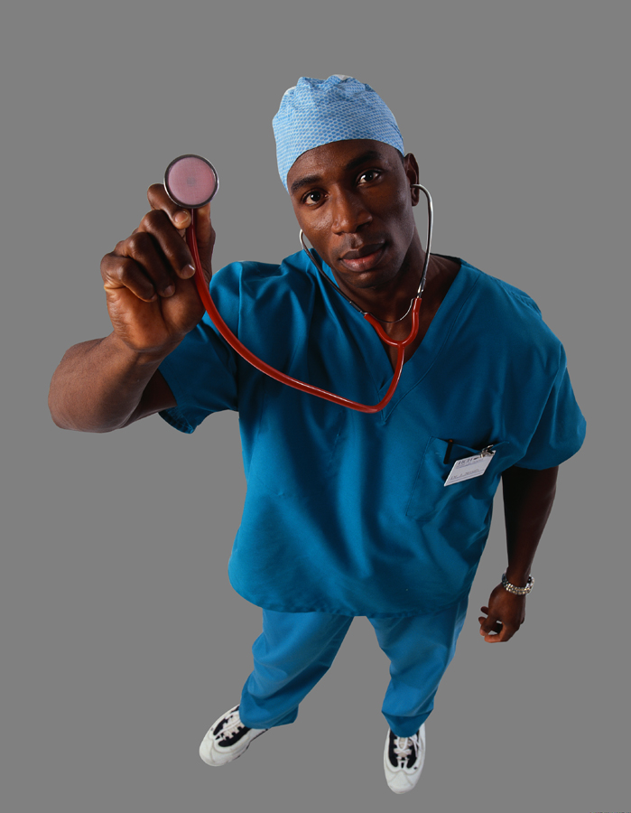
Male Health Concerns

Slide 55
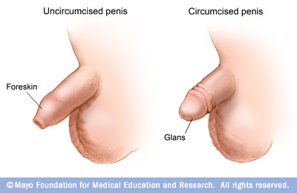
Circumcision
Removal of the foreskin
Health risks for uncircumcised men:
  Smega can cause bacteria to grow if not washed properly.

Slide 56
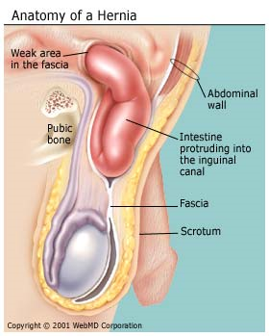
Inguinal Hernia
Intestine protrudes through a weak area in the inguinal canal.
It can be caused by an opening in the muscle wall not closing before birth.
Heavy lifting , strain

Slide 57
Testicular Cancer
Is an abnormal, rapid and invasive growth of cancerous cells in the testicles

Slide 58
Testicular Cancer
Most common cancer among men ages 15-34 years old.
Signs and symptoms:
  Slight enlargement of one of the testes
  A small, hard lump, change in testicle
  A dull ache in the lower abdomen or groin
  Heaviness in testicle

Slide 59
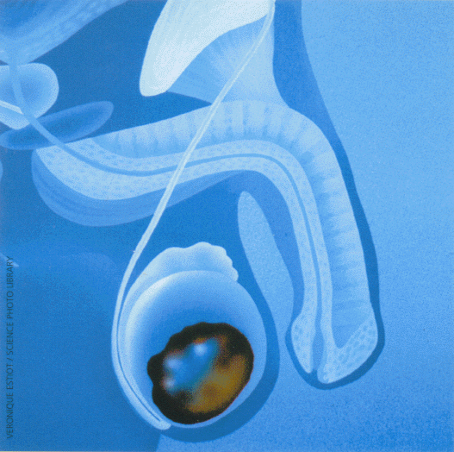
Factors increasing risk:
Undecended testicle
Abnormal testicular development
Exposure to certain chemicals
HIV
Family history
Low testosterone level

Slide 60

Self-Examination
Should be done each month after a warm shower.
  Roll each testicle gently between the thumb and fingers of both hands.
  Checking for hard lumps or nodules.

Slide 61
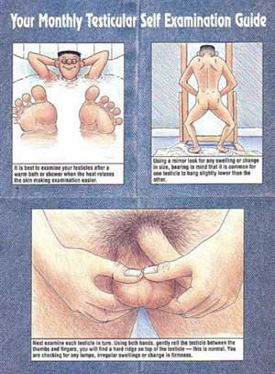

Slide 62
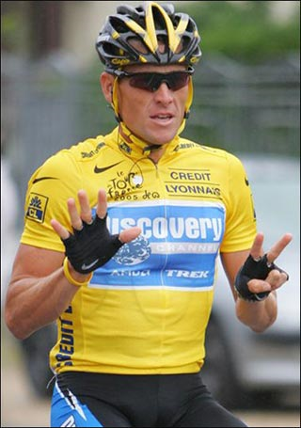

Lance Armstrong
At age 25 Lance Armstrong was diagnosed with Testicular Cancer. He ignored the signs and symptoms he was having 3 years prior to his diagnosis. The cancer spread to his lungs and brain also.
If left untreated Testicular Cancer can spread to other parts of the body.

Slide 63
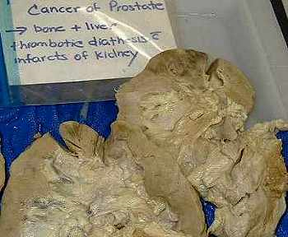
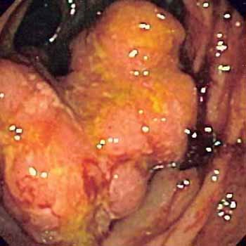
Prostate Cancer
Over 80% are diagnosed in men over the age of 65.
Symptoms:
  Frequent urination
  Difficulty urinating
  Pain in urination
  Blood in urine
  Pelvic pain

Slide 64
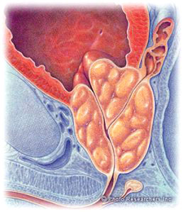
Prostate Cancer
3rd most common cause of death from cancer in men.
Cause: unknown, may be a relationship with dietary fat and increased testosterone

Slide 65

Prostatitis: inflammation of prostate gland
Generally a bacterial infection
STI’s
Any organism that causes urinary tract infection can cause prostatitis
Similar symptom as prostate cancer

Slide 66
Symptoms of Prostatitis
Chills
Fever
Abdominal discomfort
Burn during urination
Difficulty urinating
Pain with ejaculation

Slide 67
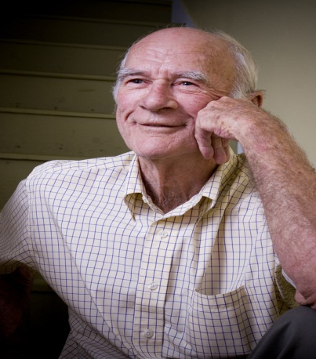
Andropause
Also known as male menopause
Occurs in men between the ages of 40 and 55.
Treatment—testosterone patch
Testosterone levels drop and may cause mood changes, fatigue, a loss of energy, sex drive, and physical agility.

Slide 68
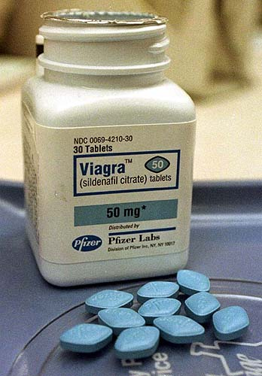
Impotence
Inability to achieve an erection.
Possible causes:
  Smoking
  Alcohol Abuse
  High Blood Pressure
  Prostate Cancer

Slide 69
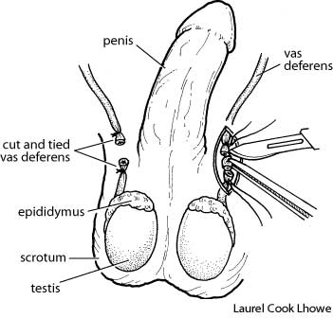
Sterility
Inability to have children may be a result of a low sperm count
vasectomy

