Slide 1
Mental & Emotional Health
Understanding mental and emotional needs

Slide 2
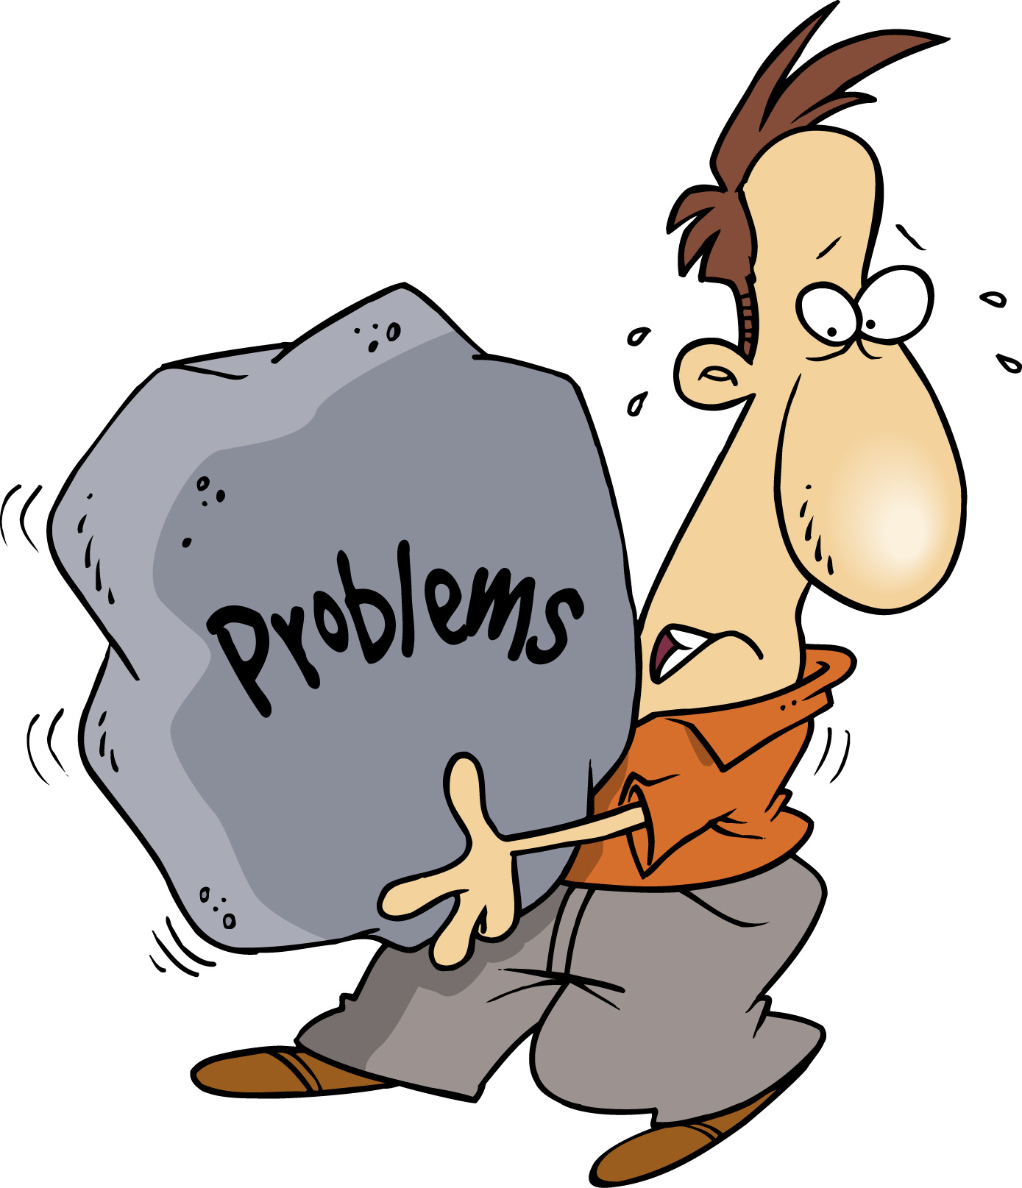
What is Mental and Emotional Health?
Definition: The ability to handle the stress and changes of everyday life in a reasonable way.

Slide 3
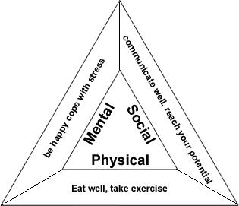
Where does Mental & Emotional Health begin?
Physical and social health influence your mental and emotional health.
Must feel the need to give and receive love, to feel recognized and feel connected with the people you trust.

Slide 4
Accepting Who You Are
Accepting yourself is a key part of your mental and emotional health.
Recognize strength and improve weakness
Personality – a combination of your feelings, likes, dislikes, attitudes, abilities and habits
Influences on your personality include:
Heredity
Environment
Behavior

Slide 5
Signs of Mental and Emotional Health
Some ways to build strong mental and emotional health
Have a good attitude and positive outlook
Recognize strengths and work on weaknesses
Set realistic goals
Act responsibly
Be able to relax and have fun alone or in a group
Be aware of your feelings and express them in healthy ways
Practice empathy
Accept constructive feedback and the messages people give you about yourself without getting angry

Slide 6
Be Resilient!
Resilience is the ability to recover from problems or loss.

Slide 7
Mental and Emotional Disorders
Definition: illnesses that affect a person’s thoughts, feelings and behavior.
Many Causes
Physical factors – drug use, diseases, accidental brain injury
Heredity
Emotional stressors

Slide 8
Types of Mental and Emotional Disorders
Anxiety Disorders
Mood Disorder
Panic Disorder
Phobias
Obsessive – Compulsive Disorder
Post – traumatic stress disorder
Depression
Bipolar disorder

Slide 9
Signs of Mental & Emotional Problems
Loss of appetite
Not taking care of physical appearance
Problems sleeping
Sad
Hear voices

Slide 10
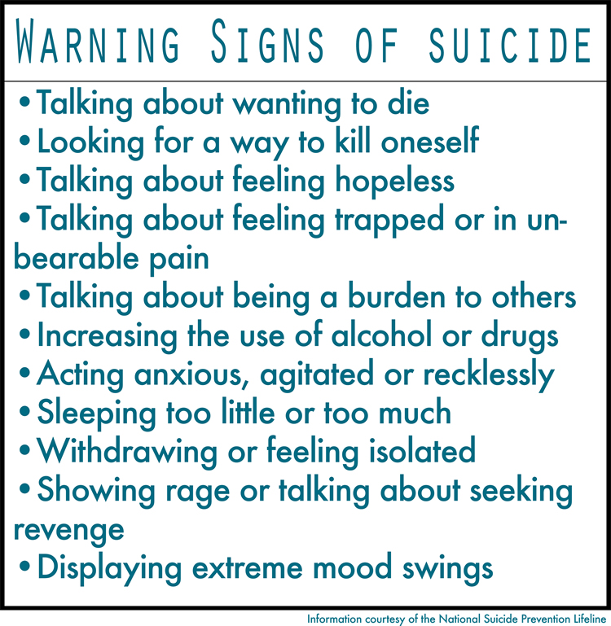
Suicide
The act of killing oneself on purpose.

Slide 11
Help for Mental and Emotional Problems
Medical treatments and counseling
Group, individual, family
Where to find help:
Resources – places to get information support and advice
Referral – a suggestion to seek help or information from another person or place

