Slide 1
Media

Slide 2
The Effect of the Media
The media effects SEXUALITY in many ways!
Our Values!
Our Behaviors!
How we dress (Trends, celebrities, magazines, TV stars)
How we act
What we do (social norms! Texting, social media)

Slide 3
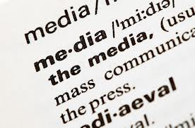
The Effect of the Media through Advertising
Advertising plays into sexuality in many different ways, you may not even realize it!
“Everyone is doing it!” Bandwagon
Brand Loyalty
“Consumers love the product so much, they bought it again, and again!”
Testimonials of consumers

Slide 4
Methods of Advertising
Packaging of products
Advertisers like to catch the eye of the consumer by having bright packaging, and flashy logos that are intriguing.

Slide 5
Exaggeration
The advertisers make the consumer think that is they use this product they will be better than they are now.
The product can transform the consumer.

Slide 6
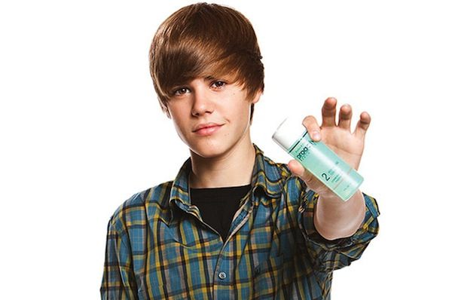
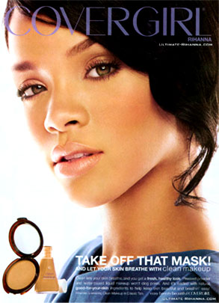
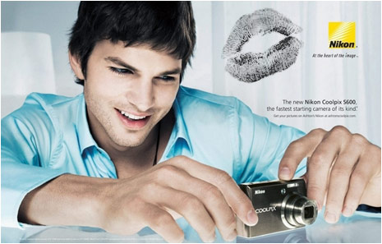
Celebrity Endorsement

Slide 7
Subliminal Advertising
Hiding information that consumers do not realize their brain is picking up on.
Pictures
Sounds
Phrases

Slide 9
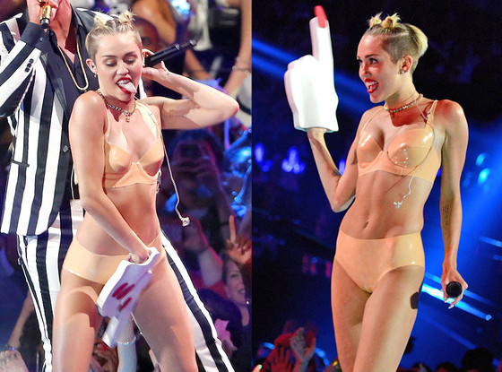
Youth behaviors and the Media
The media is swarming with celebrities that are bad role models

Slide 10
As we go through life we must remember what values we hold true to ourselves. The media will try to influence you, but if you are true to yourself and your values in life you will not be easily swayed.

