Slide 1
Total Health
Understanding Health and Wellness

Slide 2
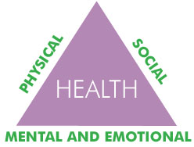
What is health?
Definition: a combination of physical, mental/emotional and social well-being.

Slide 3
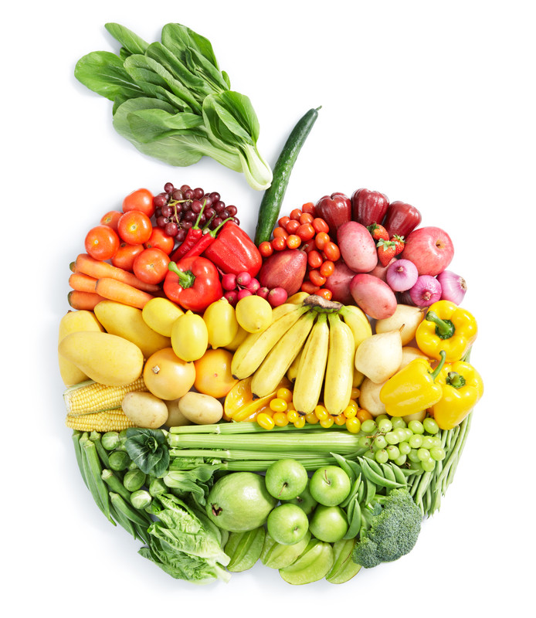
Health Triangle: Physical Health
Definition: Condition of your body.
Well balanced diet
Regular physical activity (30-60 minutes per day
Plenty of sleep (most teens need 9 hours)
Visits to the doctor
Healthful hygiene habits
Wear protective equipment
Follow safety rules
Avoid risk-taking behaviors and harmful substances.

Slide 4
Health Triangle: Social Health
SOCIAL HEALTH
Definition: How you relate to people at home, at school and everywhere else in your world.
Strong friendships
Warm family relationships
Skills: encourage, support, communicate, listen, be considerate

Slide 5
Health Triangle: Mental / Emotional Health
MENTAL/EMOTIONAL
Definition: Mental - ability to solve problems and handle the daily events of your life. Emotional health involves feelings such as happiness, sadness and anger.
Face challenges in a positive yet realistic way
Take responsibility for your actions
Stress management
Feel in control of your life.

Slide 6
Health vs. Wellness
What is the difference between health and wellness?
Definition of wellness: a state of well-being or balanced health over a longer period of time.
Health constantly changes.
How can YOU maintain overall wellness?

Slide 7
Skills for Building Health
1. Learn health skills through reliable sources. A reliable source is one that is trustworthy and dependable.
2. Self Management is taking care of your personal health and practicing healthful behaviors.
3. Stress Management means identifying sources of stress and learning how to handle them in ways that promote good mental/emotional health.
4.Analyze Influences – your decisions have to do more than just knowing the facts. They must also do with your own values and beliefs.
5. Communication Skills is the sharing of thoughts and feelings with other people (Refusal skills, Conflict Resolution)
6. Decision Making and Goal Setting –SMART
7. Advocacy is taking action in support of a cause.

Slide 8
VALUES
WHAT DO THEY HAVE TO DO WITH SEXUALITY?

Slide 9
Define in your own terms, what are values?
Values: personal inventory of what YOU consider most important
Taking the time to think about personal values can help you make choices….
Values are the principles that we believe in!
What we see as right and just.
Values should guide our behavior
Where do YOU think you learn your values?

Slide 10
Values come from…
Values are first learned from our parents or other caregivers, even our peers!

Slide 11
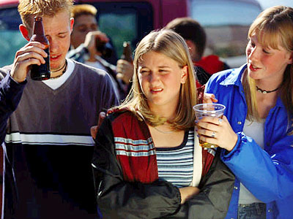
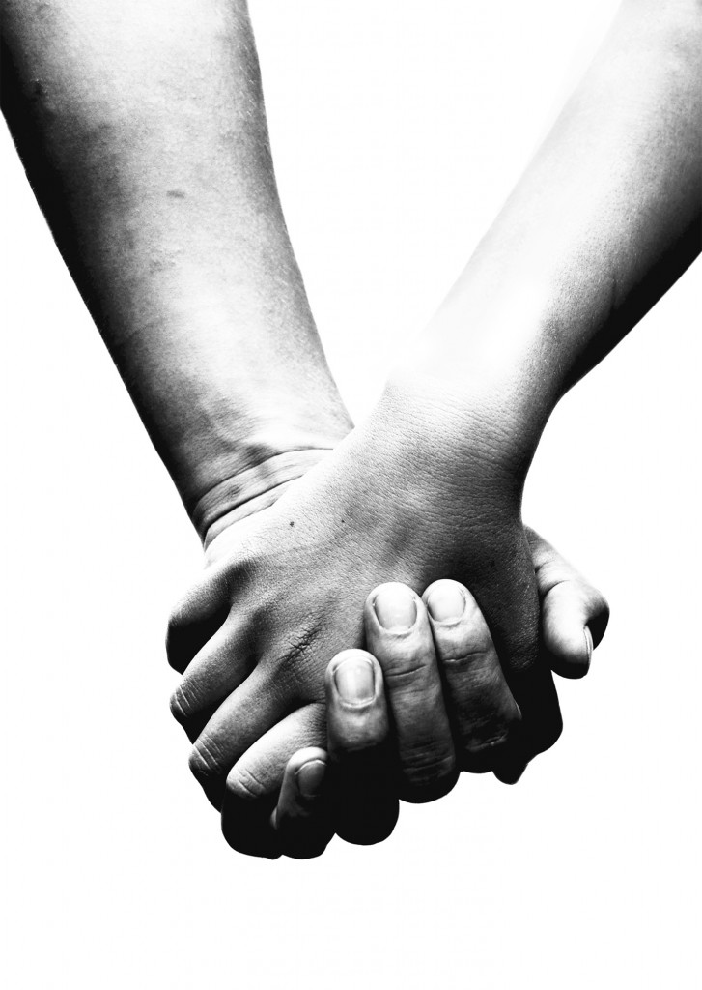
Values come from…
Our values that we learn from our family can be altered through
Media messages
New friends with different beliefs
Developing intimate relationships

Slide 12
Why?
Why do you think….
developing intimate relationships
making new friends
paying attention to media messages
… gives you opportunities to make decisions about sexuality?

Slide 13
Look closer!
It is important that you take the time to figure out what you value in your life, especially about how you feel about sex, and your sexuality.
Take a closer look at how you value;
Love
Relationships
Sexual intimacy
Birth control
Pregnancy
Parenting
Sexually Transmitted diseases

Slide 14
Throughout your life….
Your decisions in life will be greatly affected the more you clarify, express, and act on your personal values.
Your values will change throughout your life.

Slide 15
How to know your values….
Here are some guidelines for identifying what is important to you….
Is this something that is important to you?
Do you feel good about this being important to you?
Would you feel good if people you respect knew this was important to you?
Have you ever done anything that indicates this is important to you?
Is this something you would stand by even if others made fun of you ?
Does this fit in with your vision of who you are?

Slide 16
Ultimately you are the one who decides what you value in your life!

Slide 17
Relationships
Building strong relationships is important to your overall health.

Slide 18
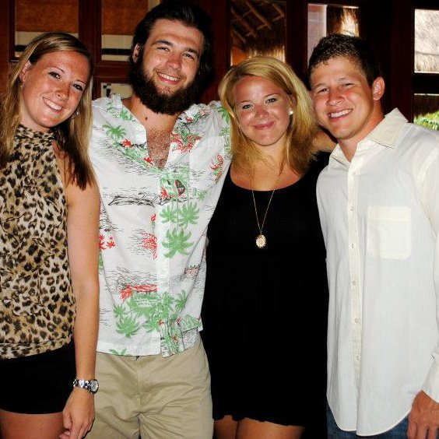
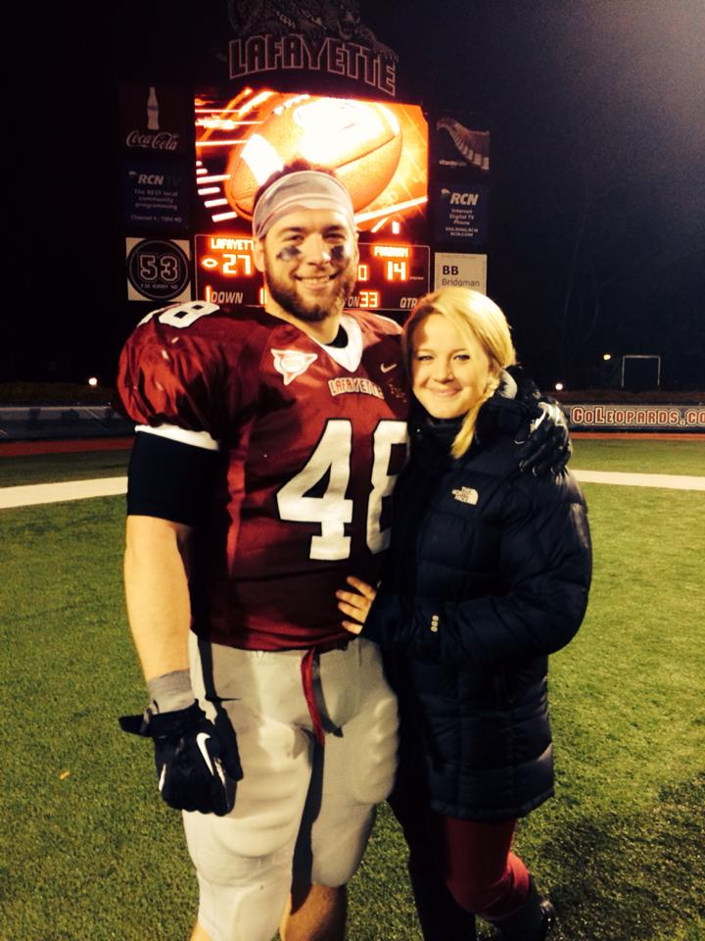
Relationships in Your Life
You have many types of relationships in your life, and you play different roles in all of them.
Building and maintaining healthy relationships can help you meet the need to belong and feel loved.

Slide 19
Types of Relationships
You have relationships with family members, friends, teachers, classmates, and people in your community.
Relationships - A bond or connection you have with other people.

Slide 20
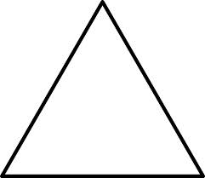
Relationships with Family
Some of the most important relationships in your life are with the family members who share your home, such as parents or guardians, brothers, and sisters.
One thing that makes family relationships special is that they last your entire life.
Healthy family relationships strengthen every side of your health triangle.
Physical
Food, clothing, and shelter
Mental/Emotional
Love, care and encouragement
Social
Values and social skills

Slide 21
Relationships with Friends
Although you probably have many friends your own age, a friendship can form between people of any age.
Friendship - A significant relationship between two people that is based on trust, caring, and consideration
Good friends can have a positive influence on your self-esteem and help you resist harmful behaviors.

Slide 22
Relationships in Your Community
Being part of a strong community has a positive impact on every aspect of your health.
It can promote healthful behaviors and also provide resources to help you when you’re in trouble.
You reinforce your ties to the community through good citizenship.
Citizenship - The way you conduct yourself as a member of the community
Good citizens work to strengthen their communities by :
Obeying laws
Being friendly neighbors
Helping to improve the places they live

Slide 23
Roles in Relationships
In the course of a single day, you may play many roles with different people.
Role- A part you play in relationships

Slide 24
Traits of a Healthy Relationship
In a healthy relationship, people respect and support each other.
Healthy relationships nurture you, bring out the best in you, and encourage you to make healthful choices in your life.
Mutual Respect
Caring
Honesty
Commitment

Slide 25
Traits of Healthy Relationships
Mutual Respect
You treat other people with respect, and they respect you in return.
You accept each other’s opinions, tastes, and traditions, even if they are different.
At times you may agree to disagree instead of trying to force your opinions on each other.
Caring
You treat other people with kindness and consideration.
During difficult times, you show empathy and support.
You’re also willing to help out others.
Honesty
You are honest and open with others rather than concealing your thoughts, feelings, or actions.
Commitment
You deal with problems in a positive way and are able to overcome them.
You contribute to the relationship and work to keep it strong, even if it means making some sacrifices.

Slide 26
Skills for Building Healthy Relationships
The Three C’s of Healthy Relationships
Communication
Cooperation
Compromise

Slide 27
The Three C’s
Communication
In relationships, people need to understand each other.
It’s important to learn effective communication skills so you can express your thoughts, feelings, and expectations to others and understand theirs in return.
Cooperation
In relationships, people need to cooperate with each other. Cooperation can strengthen your relationships.
Cooperation – working together for the good of all
Compromise
Sometimes, when people in relationships want different things, they may decide to compromise.
Compromise-A problem-solving method in which each participant gives up something to reach a solution that satisfies everyone

Slide 28
Unhealthy Relationships
Know the signs.

Slide 29
What Characterizes a Healthy Relationship?
listen to you and take your feelings and ideas seriously
talk openly and honestly with you about what matters to them
never use threats of harm, violence or suicide to get his/her own way
never hit, punch, kick, bite, slap, push or otherwise strike out in anger or jealousy
not try to control what you do, where you go or who you talk to
respect you, and say good things to you and about you
enjoy spending time with you, and show it whether alone with you or in a group
trust you, and earn your trust by keeping your confidences
allow you to enjoy the activities and people that matter to you
accepts your limits about sexual activity, every time.

Slide 30
What Characterizes an Unhealthy Relationship?
Believing one person has more rights that the other.
Shouting or yelling when you are angry at your partner.
Using the silent treatment.
Pestering your partner until you get what you want.
Pouting to get what you want.
Excessive calling, texting or emailing.

Slide 31
Why is it sometimes difficult for someone to acknowledge that they are in an unhealthy relationship? Love is Blind
People who are in unhealthy relationships often believe things will get better, the problems are just a phase or that they can change their partner. Sometimes they will have seen this type of behavior in another relationship, for example at home and not realize that the characteristics are unhealthy.
Teens may feel that having a boy/girl friend is more important than getting out of an unhealthy relationship. They may be scared to break it off either because they feel they cannot cope without the other person or the other person may be abusive or violent towards them.

Slide 32
If someone is in an unhealthy relationship what can they do about it?
It is important to acknowledge unhealthy characteristics in a relationship before they become abusive characteristics. Emotional abuse such as verbal attacks may eventually turn into physical or sexual abuse.

Slide 33
Abusive Relationships
Questions that may help identify an abusive relationship
Are you frightened by your partner’s temper?
Are you afraid to disagree?
Are you constantly apologizing for your partner’s behavior, especially when they treated you badly?
Do you have to justify everything you do, every place you go, or every person you see to avoid your partner’s anger?
Does your partner put you down, but then tell you that s/he loves you?
Have you ever been hit, kicked, shoved, or had things thrown at you?
Do you not see friends or family because of your partner’s jealousy?
Are you afraid to break up because your partner has threatened to post personal photos of you online?
Have you been forced into having sex when you didn’t want to?
Are you afraid to break up because your partner has threatened to hurt you or themselves?

