Slide 1
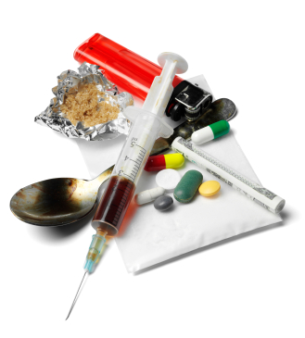
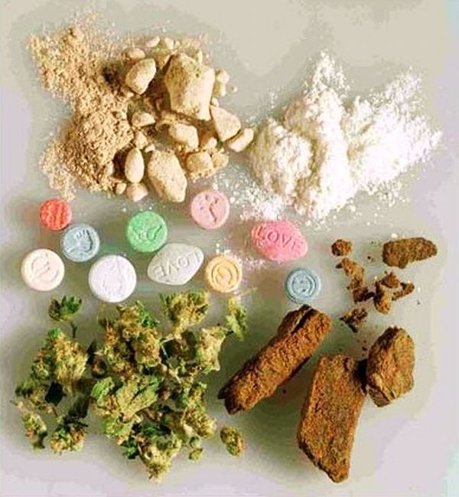
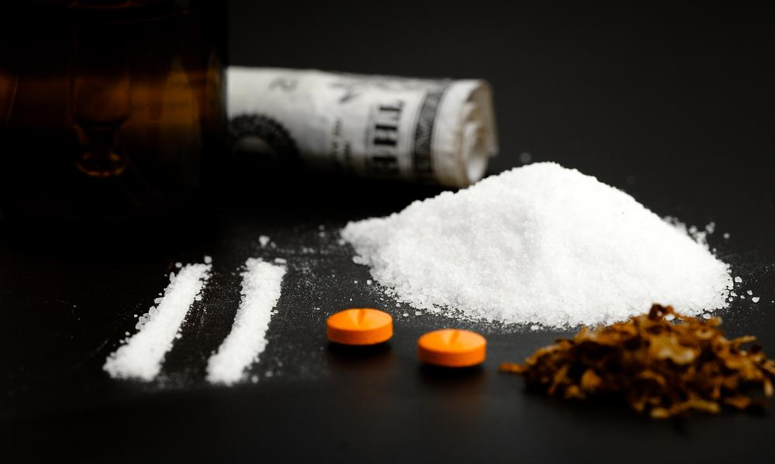
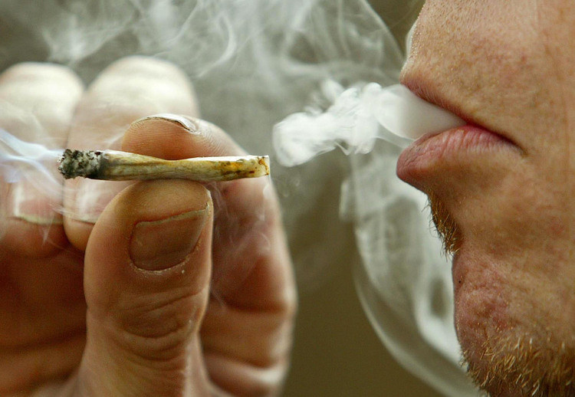
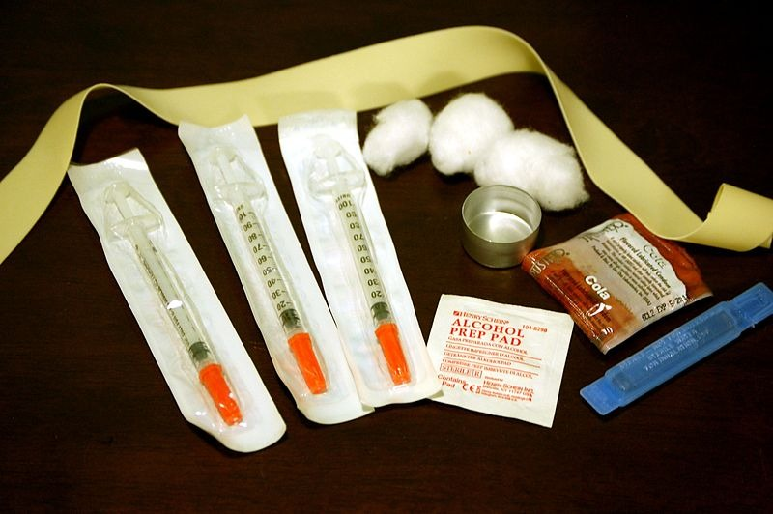
Drugs

Slide 2
Drug Use and the Body
ALL drugs affect the body in some way but the same drug can affect people differently
Tolerance – The body’s need for larger and larger amounts of a drug to produce the same effect.
Overdose – Taking more of a drug than the body can tolerate.
Video Clip: https://www.youtube.com/watch?v=lOLb21bii-A

Slide 3
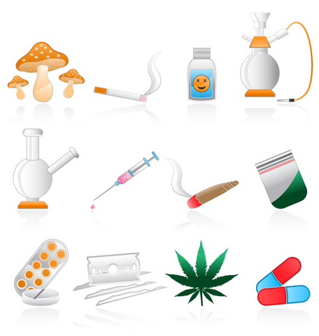
Types of Drugs
Stimulants
Depressants
Club Drugs
Narcotics
Hallucinogens
*All drugs can be harmful to your physical, mental/emotional, and social health*

Slide 4
Stimulants
Stimulants – A drug that speeds up the body’s functions.
Speed up heart and breathing rates and raise blood pressure, give false sense of energy, wellbeing, confidence and power.
Amphetamines – Strong stimulant drugs that speed up the nervous system
Sometimes prescribed to treat certain medical conditions such as ADD & ADHD
Often called “speed”
Can be swallowed, inhaled, smoked or injected
Crystal Meth – Methamphetamine
Cocaine – Coca plant – Known as: blow, snow or coke

Slide 5
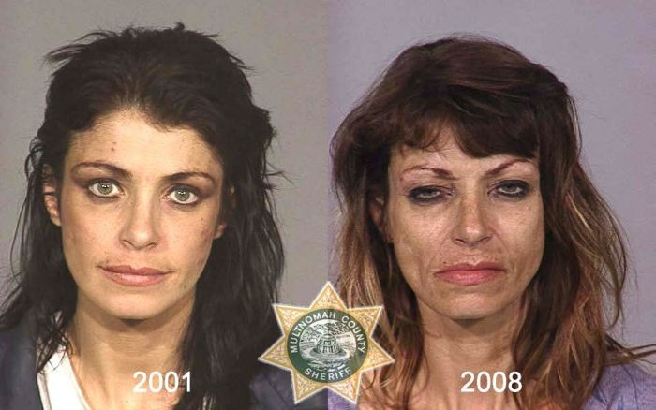
Methamphetamine

Slide 6
Methamphetamine

Slide 7
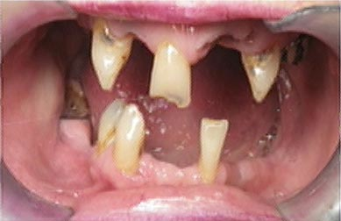
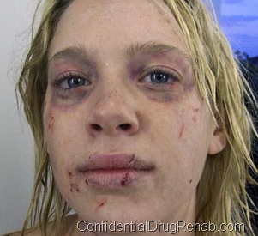
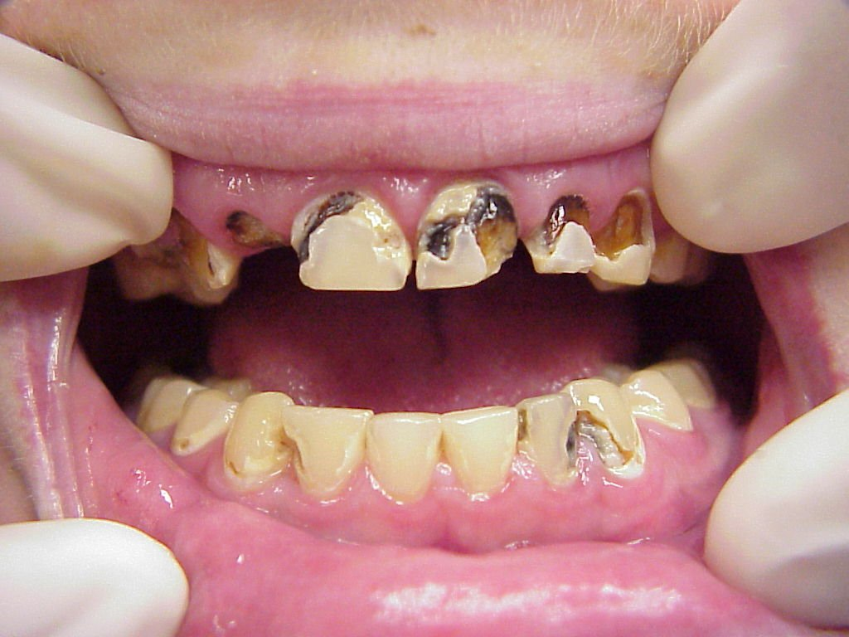

Slide 8
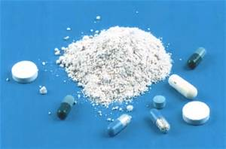
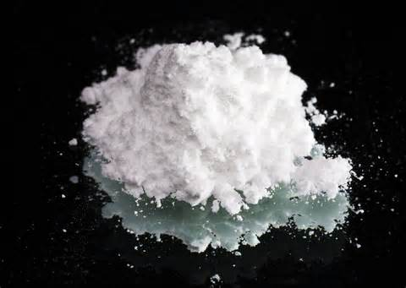
Stimulants
Amphetamine
Cocaine

Slide 9
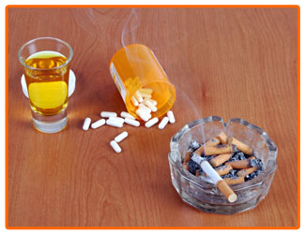
Depressants
Depressants- Drugs that slow down the body’s functions and reactions, including heart and breathing rates.
Slow down a person’s motor skills and coordination.
Most come in tablet or capsule form
Common depressants: Alcohol, Barbiturates, tranquilizers
Highly addictive

Slide 10
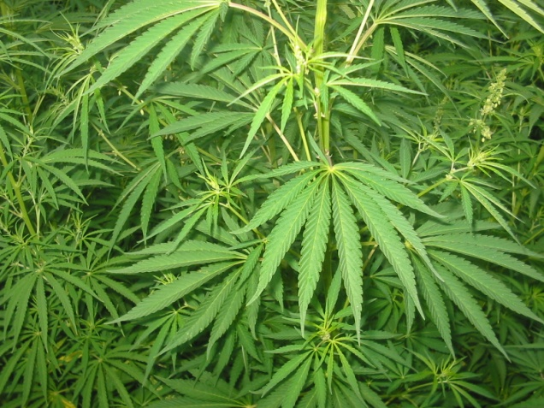
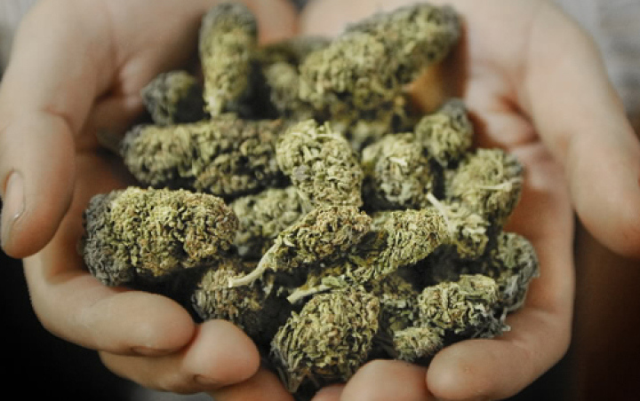
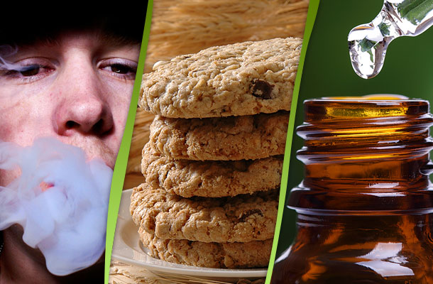
Marijuana
Marijuana – Drug made from the dried leaves and flowers of the hemp plant, Cannabis Sativa.
Acts as a stimulant for some and as a depressant for others.

Slide 11
Club Drugs
Club Drugs – Illegal drugs that are found mostly in night clubs or at all-night dance parties called raves.
Some club drugs include: Ecstasy (X), Rohypnol (roofies), Ketamine
Molly - https://www.youtube.com/watch?v=Z8jn2unqKGU
Typically made in home laboratories mixed with other harmful chemicals. There is no way to know exactly what is in them.

Slide 12
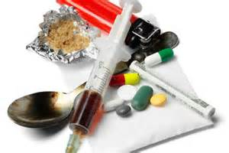
Narcotics and Hallucinogens
Narcotics – Drug that gets rid of pain and dull the senses.
Morphine and codeine (both used as medicine and highly addictive)
Heroine – usually injected, gives users an instant “high” or feeling of happiness.
Hallucinogens – Drug that distort moods, thoughts and senses.

Slide 13
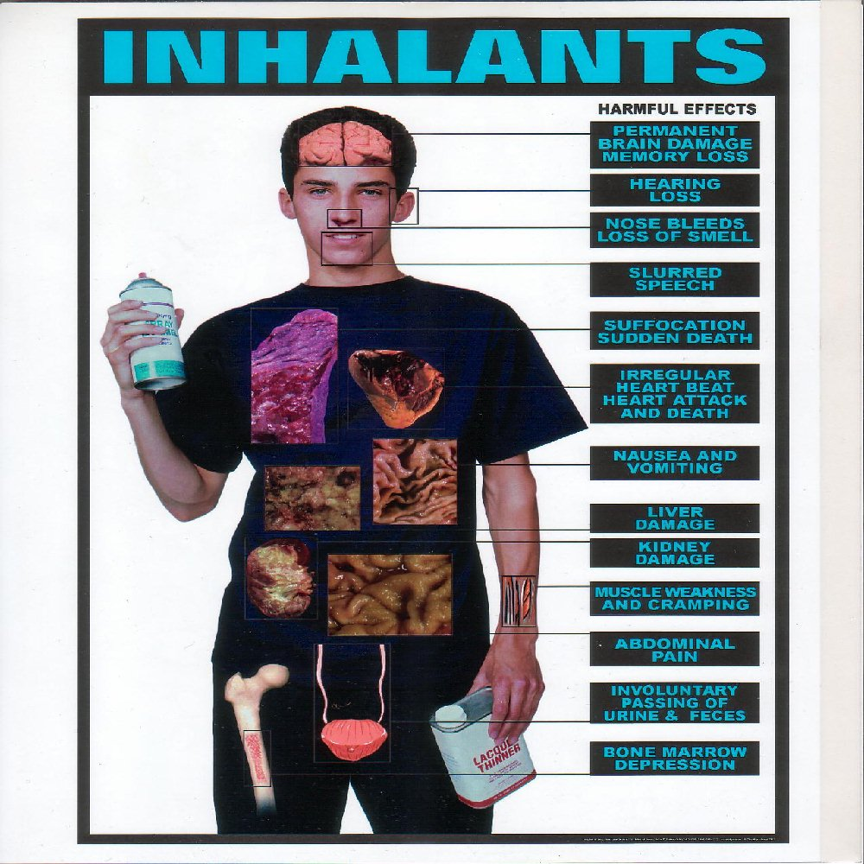
Inhalants
Inhalants – The vapors of chemicals that are sniffed, or inhaled to get a “high”
Household products
Poisons go straight to the brain

Slide 14
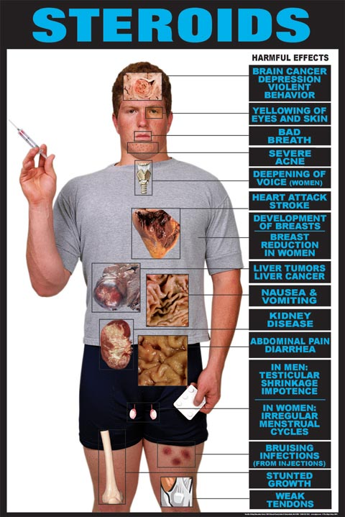
Steroids
Steroids – Drugs that are either human hormones or similar hormones found in the human body

Slide 15
Activity
Sometimes the best way to get a message across is to place it in a creative medium. With another classmate, create a poem, song, article, comic strip or poster to educate others about legal and illegal drugs. Keep your message simple and straightforward, using facts about the drug that you have learned.
Please include:
Overview on the drug
What does it look like?
Street Names
Methods of Abuse
How the drug affects mind and body
Legal status of the drug
Overdose Effects

